Slide 1
Psychology
The scientific study of
mind and behaviour
Ms Floros

Slide 2
Psychology
This course is designed for all students.
It is a challenging and interesting course that explores human behaviour
We make use of a range of teaching methods to cater for different styles of learning.
The course relies on your ability to think critically, express your opinion, and maintain a balanced argument… so there is lots of opportunity for discussion.

Slide 3
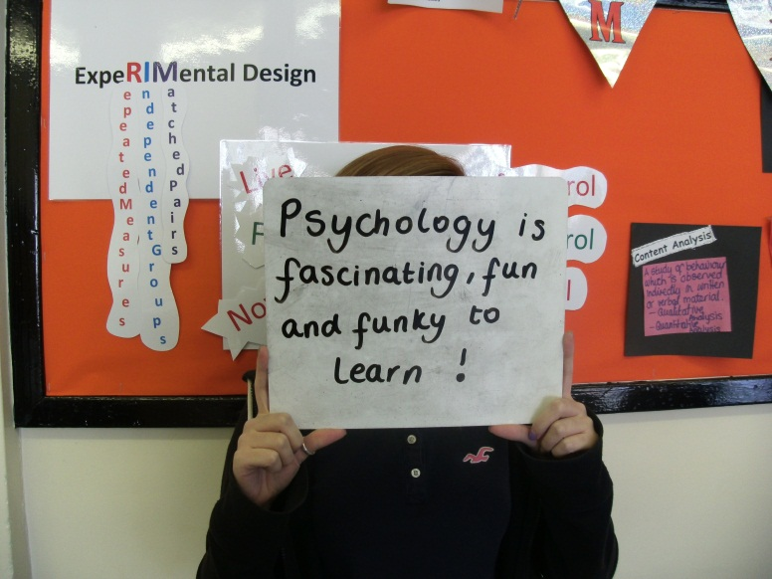
Psychology is a popular subject because it has a huge impact on every aspect of our lives. Psychology is the study of the mind, brain and behaviour; applying scientific methodology to explain behaviour. Studying psychology will provide you with lots of options for your future careers as it develops a number of valuable and transferable skills. As well as careers within areas of psychology such as sport, clinical and forensic psychology; psychology qualifications open doors to careers in disciplines such as:
Health and social care
Marketing and PR
Management
Education
Public sector work

Slide 4
Watch this!!
https://www.youtube.com/watch?v=BgRoiTWkBHU

Slide 5
Overview of Content: Papers 1 and 2
A-Level
Compulsory content
1 Social influence
2 Memory
3 Attachment
4 Psychopathology
5 Approaches in Psychology
6 Biopsychology
7 Research methods
8 Issues and debates in psychology

Slide 6
Overview of Content: paper 3
Option 1
9 Relationships/10 Gender/11 Cognition and development
Option 2
12 Schizophrenia/13 Eating behaviour/14 Stress
Option 3
15 Aggression/16 Forensic psychology/17 Addiction
Bold indicates the chosen topics.
Androgyny, and approaches in explaining where our sense of gender comes from
Classification, approaches in explaining and treating this disorder
Defining crime, profiling, explanations, and dealing with crime

Slide 8
Psychology is a science
Given that psychology is considered to be a science it is crucial that those who take the subject are aware of it’s scientific nature. The specification covers aspects that build on knowledge from GCSE science and because of this students should have a 5 or above in GCSE science.
Notes:
Maths and English C+

Slide 9
Psychology includes maths…
Embedded within this course is maths. For example, recognising and using expressions in decimal and standard form. Using ratios, fractions and percentages. Estimating results. Use of an appropriate number of significant figures. Finding arithmetic means. For example, calculating the means for two conditions using raw data from a class experiment. Constructing and interpreting frequency tables and diagrams, bar charts and histograms etc... These skills will be applied in the context of A-level Psychology and will be at least the standard of higher tier GCSE mathematics.

Slide 10
And Statistics
In Y13, we go on to understand simple probability. For example, explaining the difference between the 0.05 and 0.01 levels of significance.
Select an appropriate statistical test. For example, selecting a suitable inferential test for a given practical investigation and explaining why the chosen test is appropriate. Use statistical tables to determine significance.
Maths makes up at least 10% of the marks in the papers.

Slide 11
Psychology and English
There are a variety of question types in the papers ranging from 1 mark multiple choice up to 16 mark essays of approximately 450 words.
In order to gain higher grades in psychology, students should be able to construct coherent essays, using good English and appropriate terminology.

Slide 12
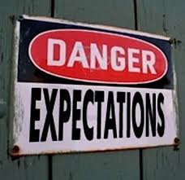
Communication
Organisation
(folders, materials, time management, meeting deadlines)
Punctuality and attendance
Private study (minimum five hours per week)
Effort Respect

Slide 13
We do our best to…
Make sure work is understandable
Provide feedback on assignments explaining how to improve
Ensure feedback is given regularly
Ensure lessons are varied and interesting

Slide 14
Questions?
Ms Floros:
m.floros@cannockchase-high.staffs.sch.uk

