Slide 1
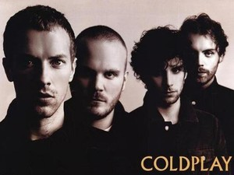
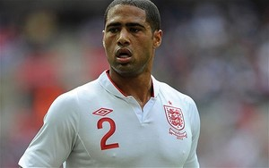
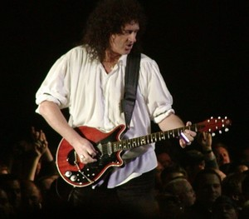
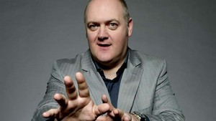
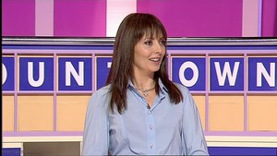
Famous A Level Mathematicians

Slide 2
Mathematics A Level
Sixth Form Open Evening

Slide 3
Requirements
To be able to enroll onto A level Mathematics:
Grade 6-9 in GCSE Mathematics
Followed the Higher syllabus
Have a love for the subject
Hard work ethic
Desirable
Need it for your future career
Just enjoy doing Mathematics

Slide 4
Content
Year 12 | Year 13
Pure Mathematics | Paper 1: Pure Mathematics 1 (2 hours)
Statistics and Mechanics | Paper 2: Pure Mathematics 2 (2 hours)
 | Paper 3: Statistics and Mechanics (2 hours)

Slide 5
How is Y12 and Y13 delivered?
All content is delivered during 5 lessons per week.
Students will either be taught by one teacher or by two teachers on a 3:2 split.

Slide 6
Assessment
Students are assessed via chapter tests and also progress check assessments once every term.
Students should expect to receive homework every week.
Independent study is also expected and students should each have their own independent study folder which is checked regularly.

Slide 7
Important Facts
All papers are with a calculator. You will need a more advanced calculator.
Casio fx991-EX is the minimum requirement.
NO COURSEWORK – all exam based.
A level Mathematics has a 2:1 ratio of pure to applied content*.
*applied maths will be statistics and mechanics

Slide 8
Reasons to study mathematics
“Students are often surprised at the extent of the mathematical demands of their university programmes and some struggle to cope with those demands.”
“Between 2013 and 2020, employment in the UK is forecast to increase by 6 per cent, whilst demand for experts in software, data storage, retrieval and analysis is expected to rise by 160 per cent, reflecting the growing UK digital economy and the increasing amounts of data garnered from the internet of things.”
BONUS – on average people earn 11% more over their lifetime with A Level Mathematics.

Slide 9
Reasons to study mathematics
The figures, from the Department for Education, draw on tax data to reveal what people in England who took their A-levels in 2010/11 were earning in 2016/17.

Slide 10
Summary
Must have at least a Grade 6 at GCSE Higher Tier.
Hard work and perseverance is necessary, but worth it in the end!
Regular attendance at lessons is essential.
A well thought-of A Level which leads into a variety of careers and university courses.

Slide 11
Questions
Questions?

