Slide 1
Law

Slide 2
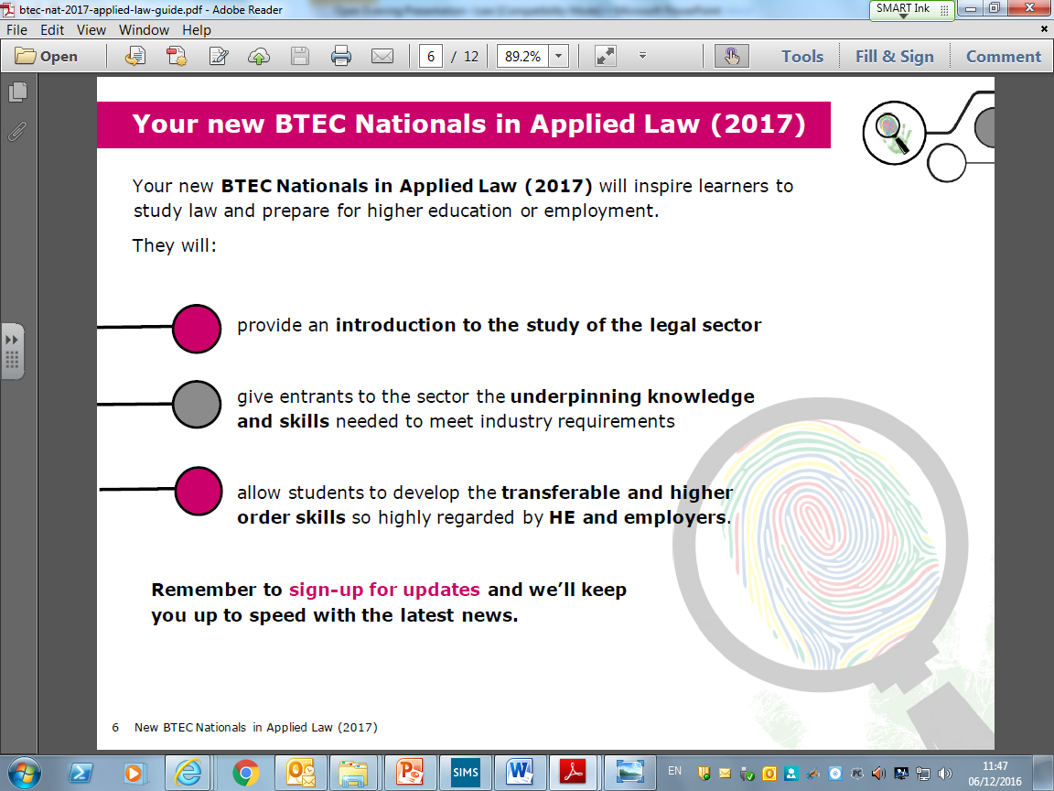

Slide 3


BTEC LAW – Course Description
The course consists of four units.
1. Dispute Solving in Civil Law (Mandatory and Externally Assessed)
2. Investigating Aspects of Criminal Law and the Legal System (Mandatory and Internally Assessed)
3. Applying the Law (Mandatory)
7. Optional coursework unit
To be decided
Law of Tort
Family Law

Slide 4
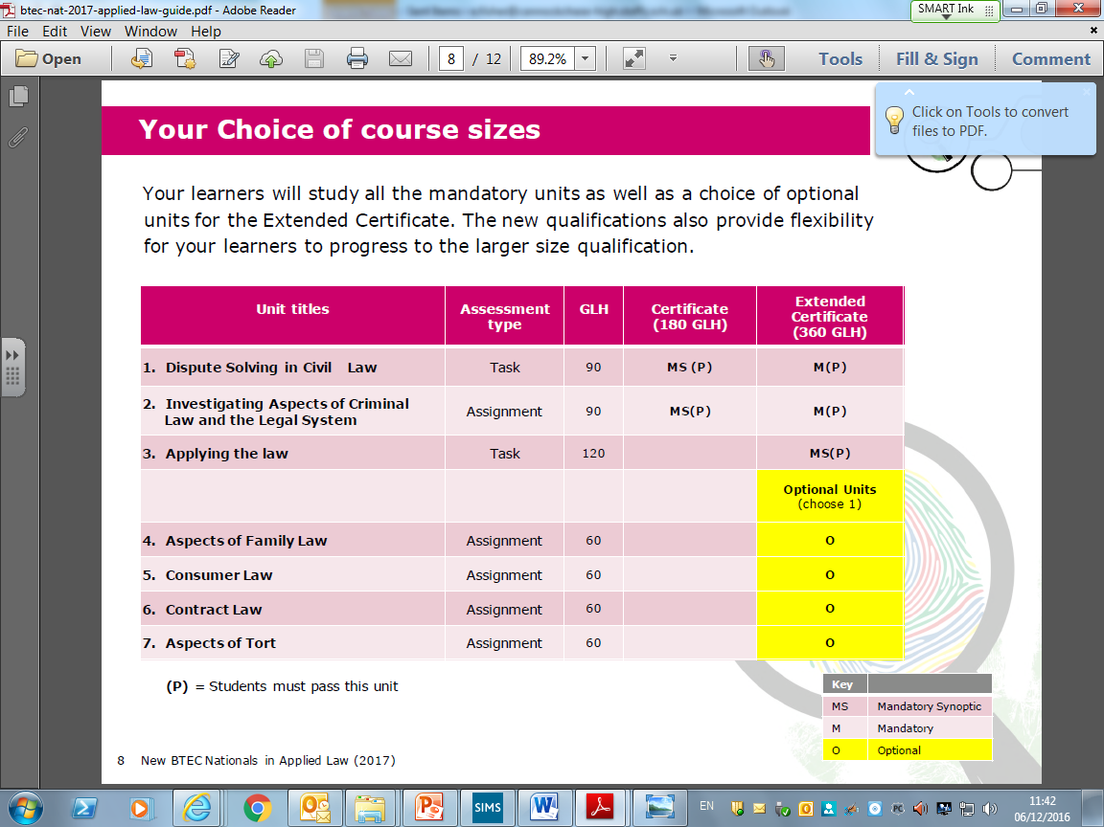

Slide 5
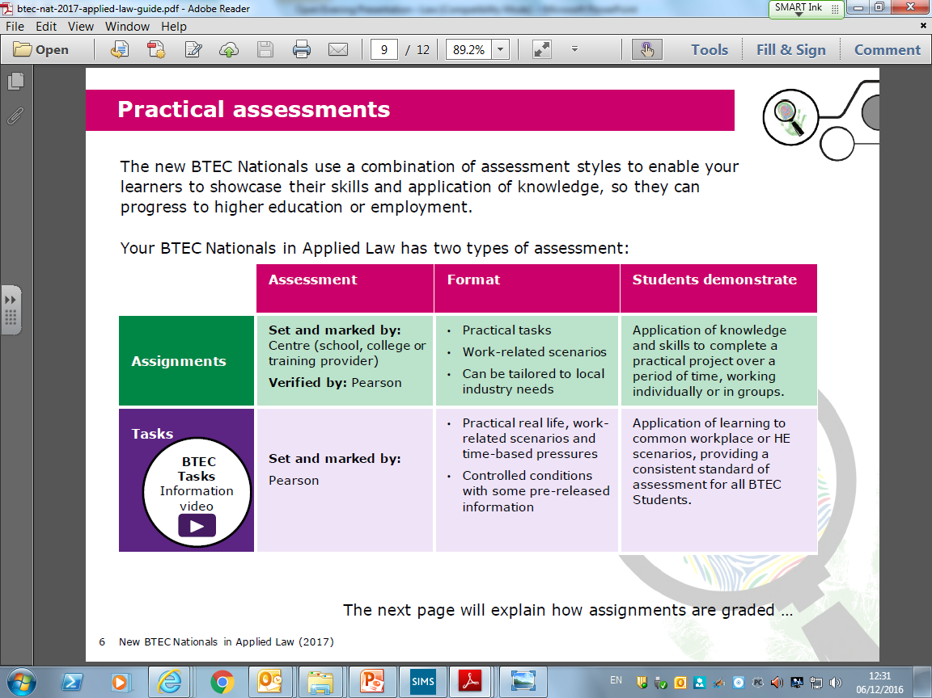

Slide 6
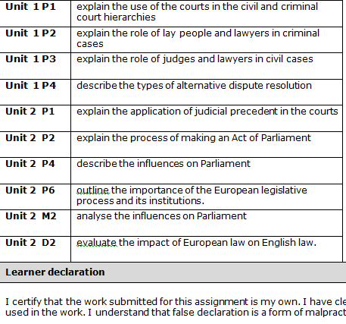
BTEC LAW
    Unit 1 and 2 – Law Making and the Legal System.
    This is an example of the criteria Pass, Merit, Distinction shown as P, M & D
      Parliamentary Law Making
      Delegated Legislation
      Statutory Interpretation
      Judicial Precedent
      Criminal Courts and Lay People
      Civil Courts and Dispute Resolutions
      Legal Profession advice and funding
      The Judiciary
      Introduction to Criminal Liability
      Underlying Principles of Criminal Liability
      The Courts: Procedure and Sentencing

Slide 7
BTEC LAW
    The next 2 slides show examples of tasks which will be completed in class to prepare you for your coursework and controlled assessments

Slide 8
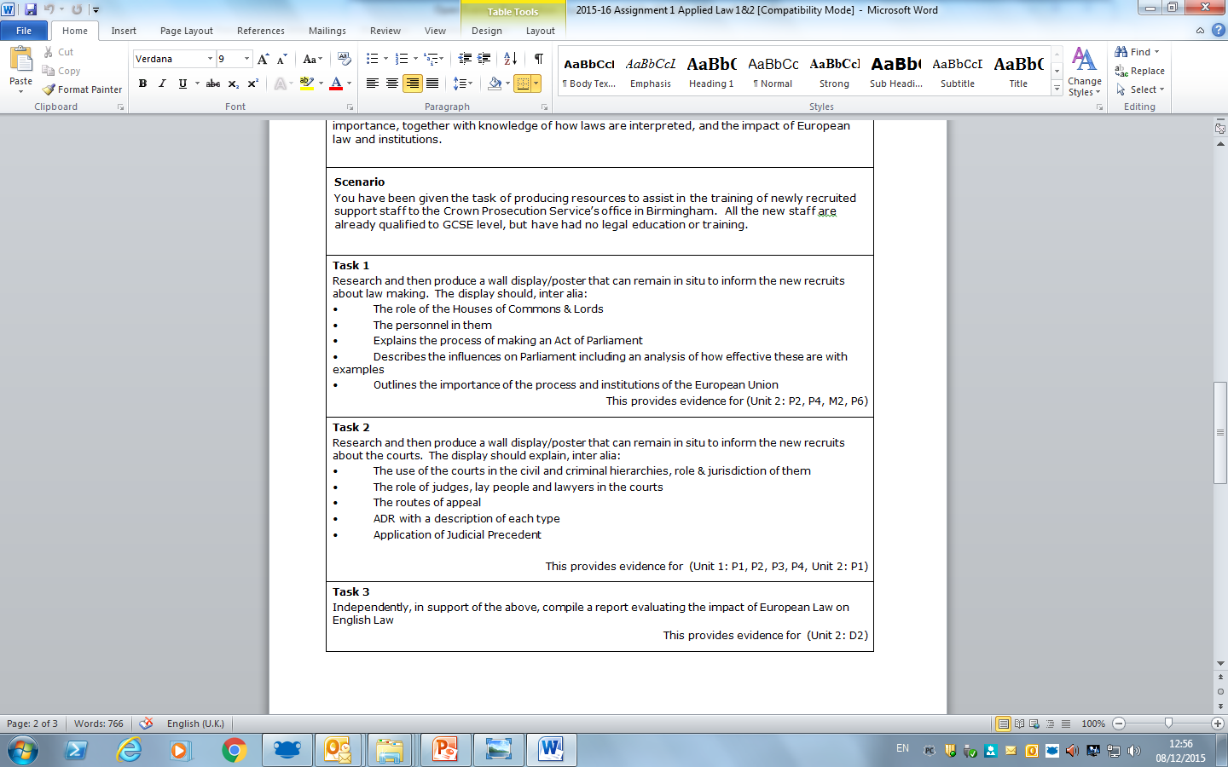

Slide 9
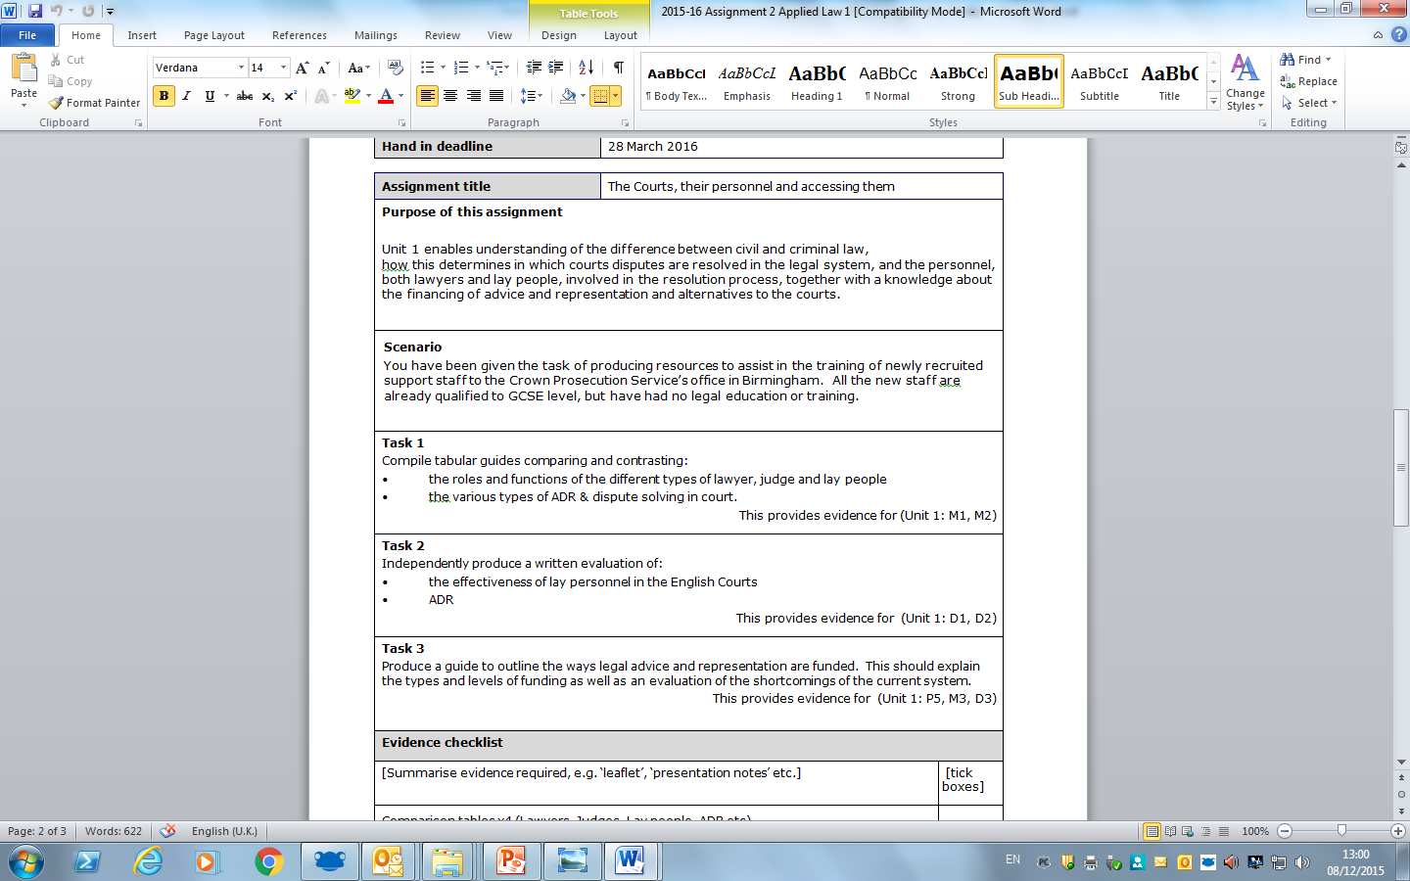

Slide 10
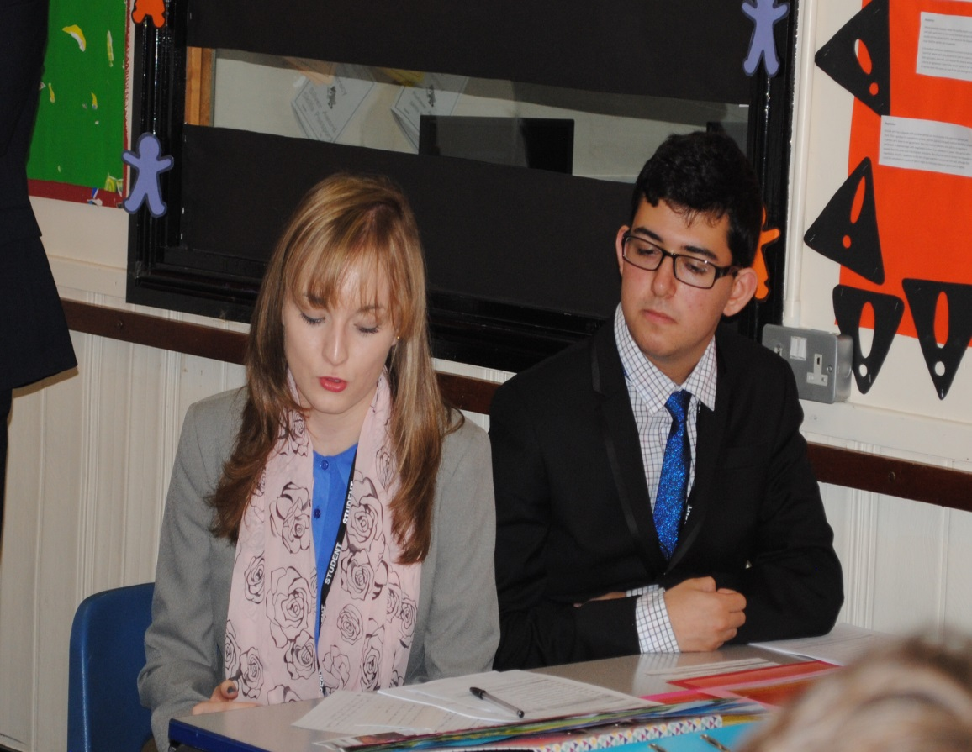
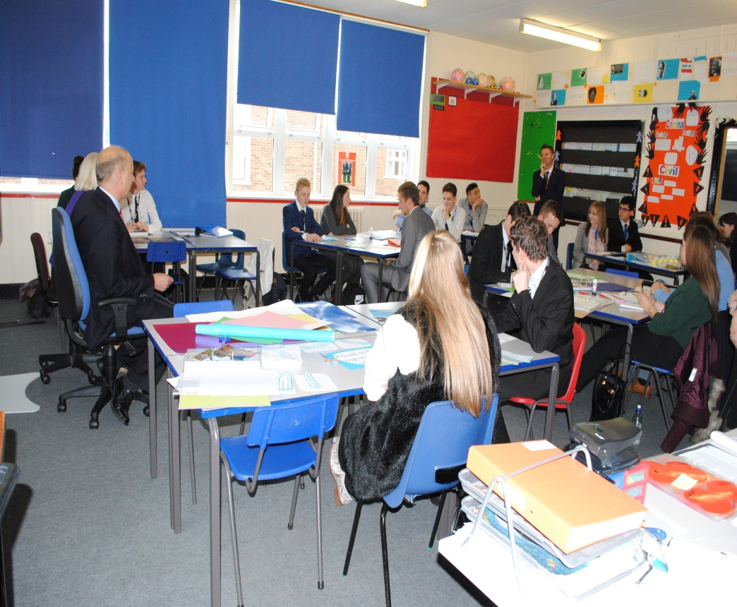
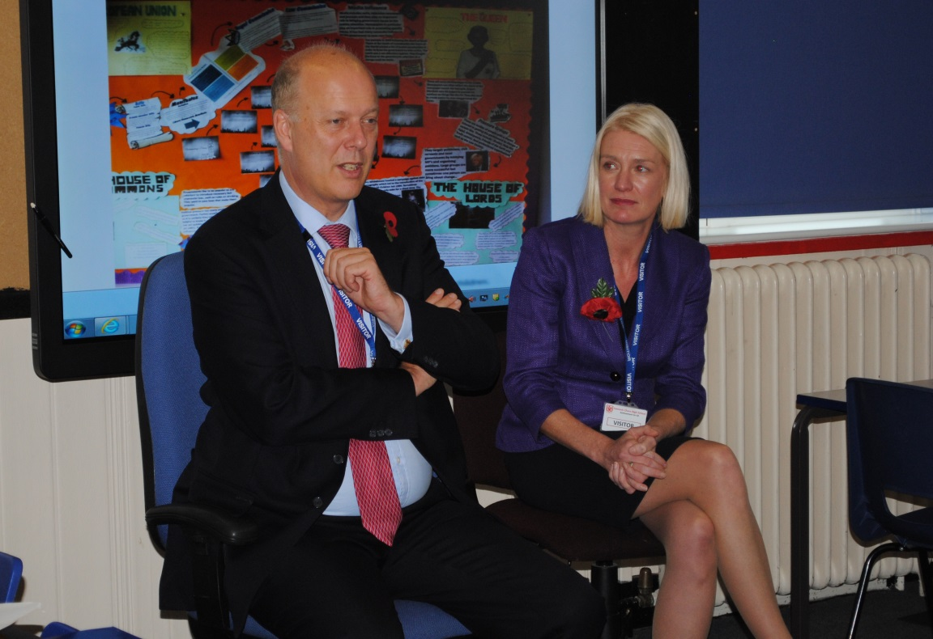
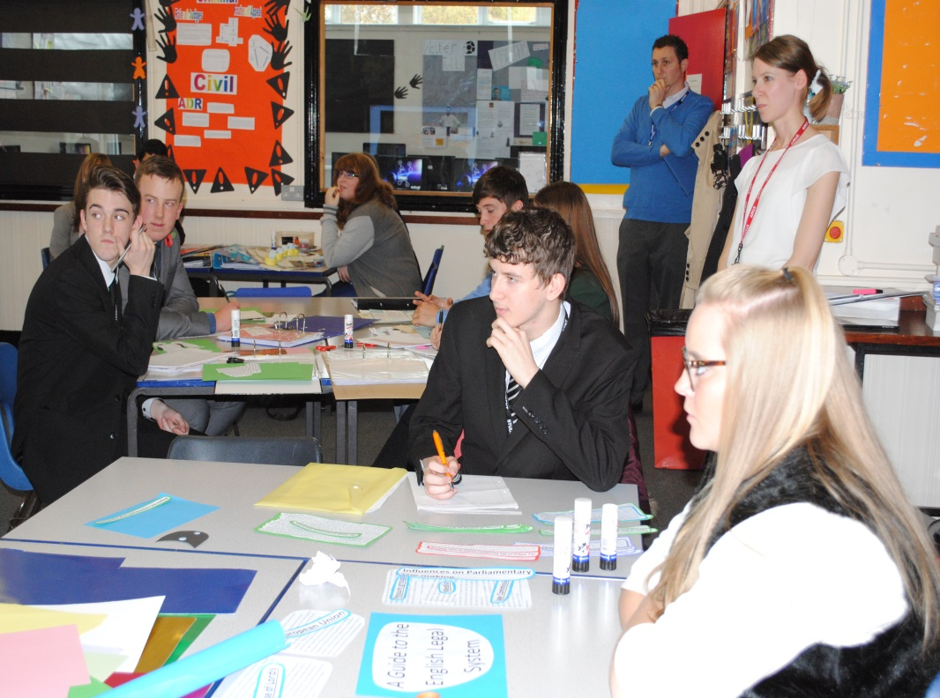

Slide 11
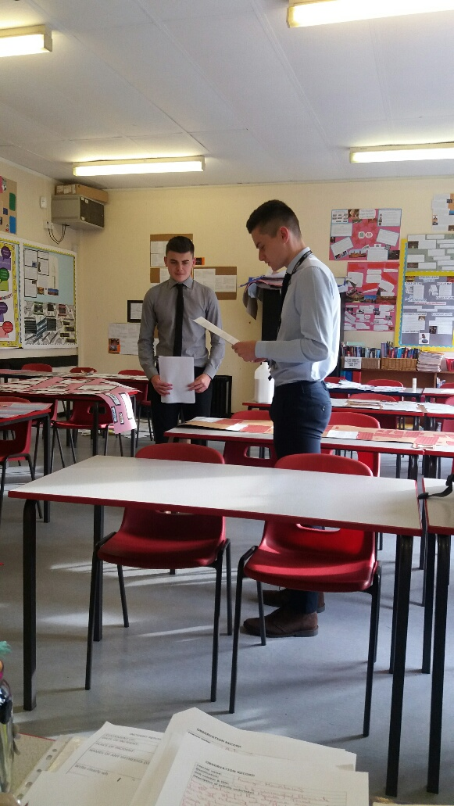
Unit 3– Applying The Law (Criminal Law)
      Murder
      Voluntary Manslaughter
      Involuntary Manslaughter
      Non-fatal Offences against the person
      Defences
      Evaluation
      Theft and Robbery
      Burglary
      Blackmail
      Fraud
      Making off without payment
      Criminal Damage
      Defences
      Police powers

Slide 12
Example of Y13 Tasks

Slide 13
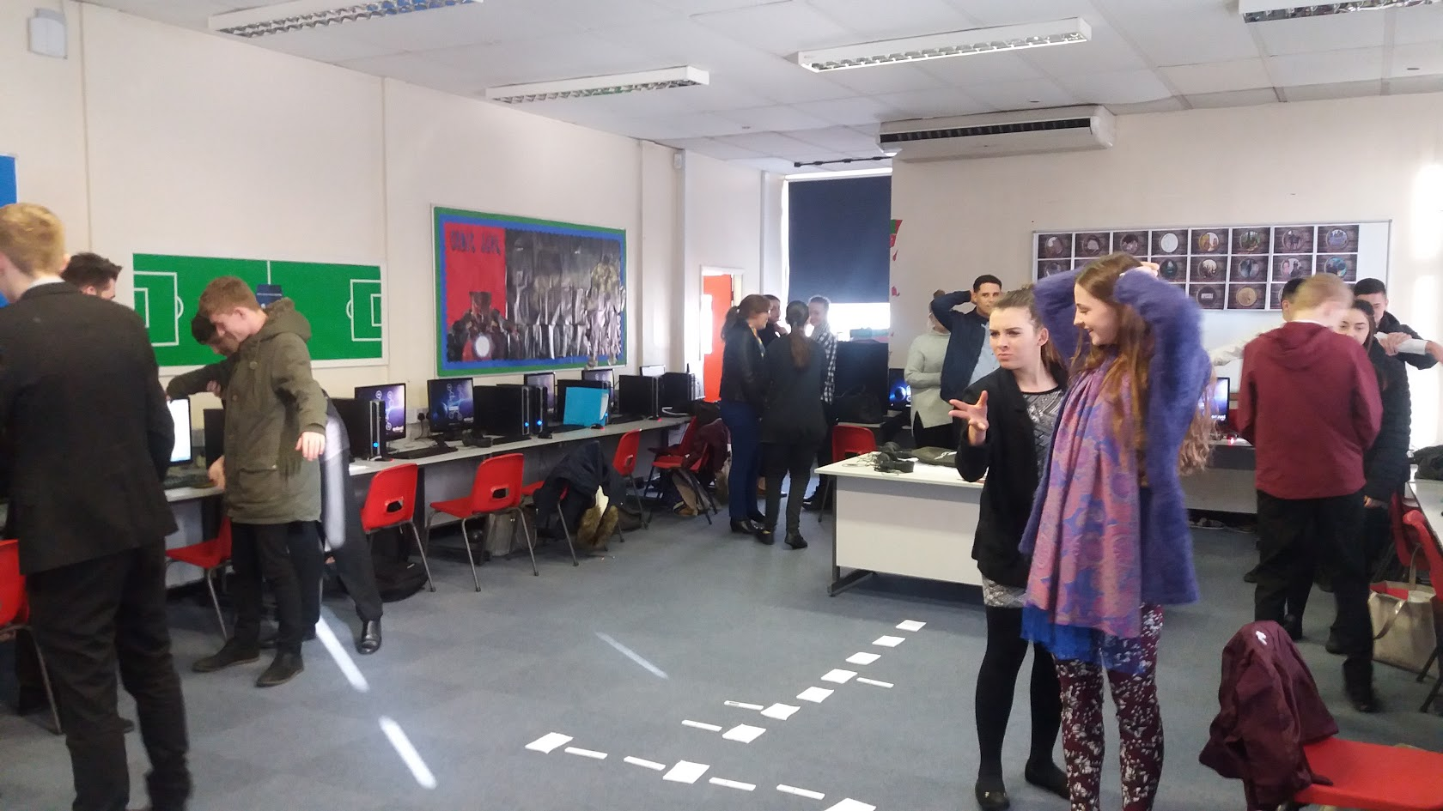
Police Powers

Slide 14
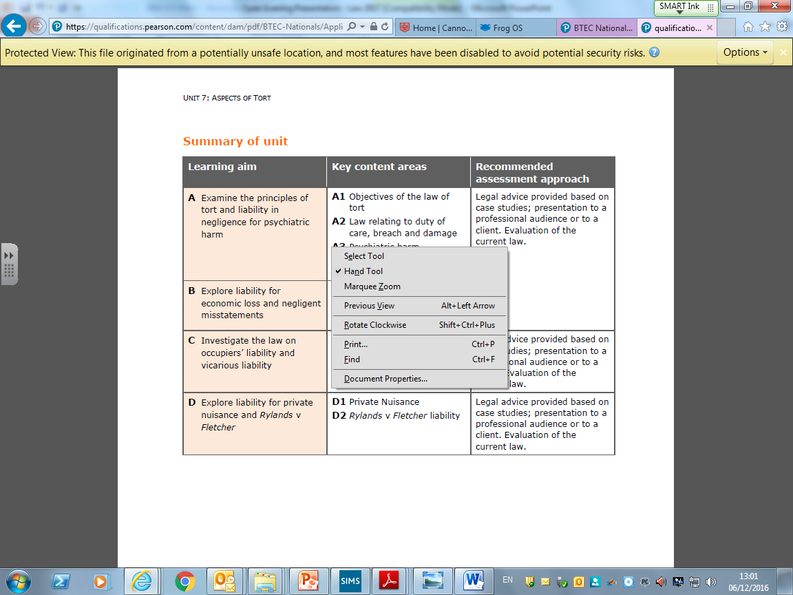
Unit 7 – Aspects of the Law of Tort

Slide 15

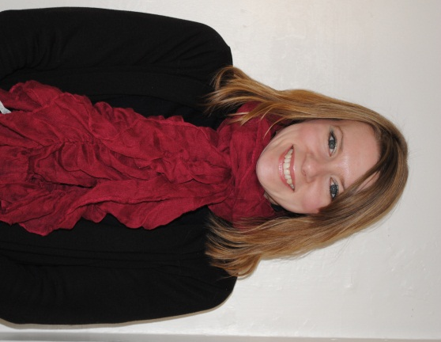
WHY STUDY LAW AT CCHS?
    Legally Trained Teacher
    Individual Support and Guidance
    Interesting and Engaging Lessons
    Links with Outside Agencies
    Materials and Guides
    Research Skills
    Ability to read legal texts
    Preparation for assessment methods used in degrees
    Analytical Skills
    Patience
    Most students achieve a D*

Slide 16
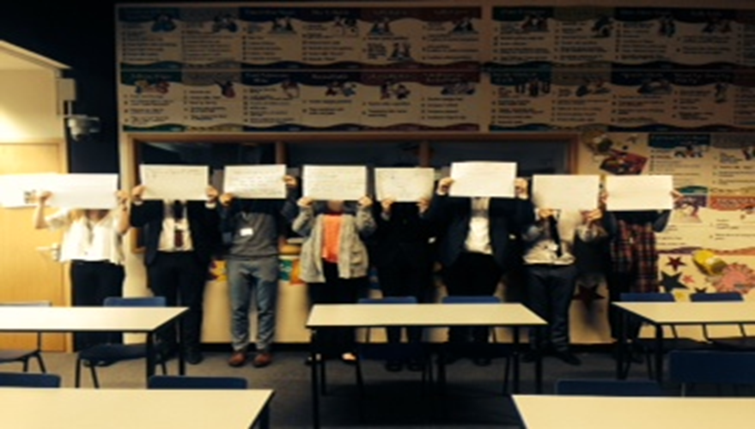
WHAT OUR LAW STUDENTS THINK
« I chose law because it is interesting, exciting and applicable to everyday life. It also links in well with my other subjects, as well as giving me knowledge of my rights in life. »
« I like law because the idea of understanding the law has always appealed to me. »
« I chose law because it gives you a greater understanding of the English Legal System and how the law actually works. »

Slide 17
CCHS Law Success Stories
Ashley
Reading Law at Birmingham University
Amy
Reading Law at Leeds University
Chloe
Social Work at Hull University
Natasha
Reading Law at Derby University
Abbie
Studying Criminology at Edge Hill
George
Reading Law at
Bristol University

Slide 18
WHAT WE EXPECT FROM YOU
  Dedication
  Organisation
  Enthusiasm
  Participation
  Honesty

Slide 19
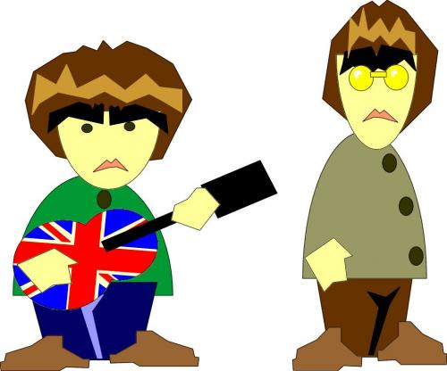



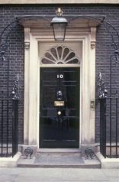

Examples of Cases we will study
R ‘V’ Gallagher
1
1
McNaughton Rules
R V Sullivan

Slide 20
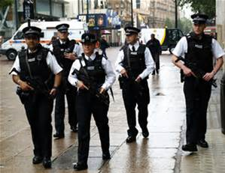
LEGAL TRAINING & JOBS
Law Degree – LLB HONS
Legal Practice Course
BAR Exams ( Barrister)
Business Studies
Forensics
Criminology
Criminal Psychologist
Criminal Sociology
Police
Legal Secretary
Magistrates Clerk
Judge
Solicitor
Barrister
Lecturer
Teacher

Slide 21
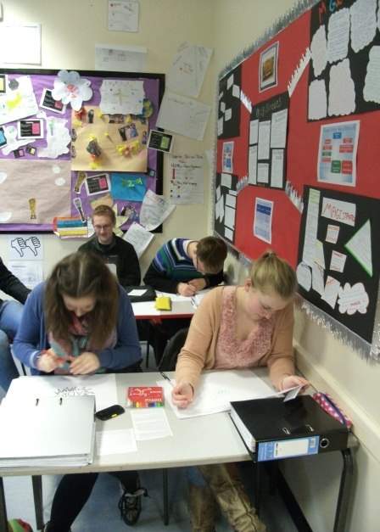
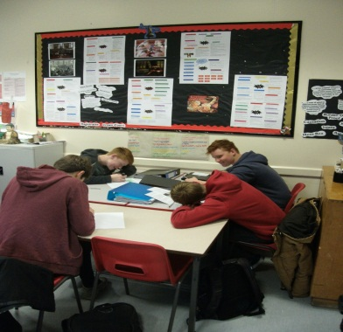
Students at Work and Their Comments
“ c” Until I studied Law I never knew Intoxication is not an excuse.”
1
1
“ I I was shocked when I found out that you do not have to hit someone to assault them.

