Slide 1
Welcome to History
Why study History A level at Cannock Chase High School?
Well, quite simply, it is amazing!
Great Teaching, Wonderful resources, Fascinating topics, Engaging lessons

Slide 2
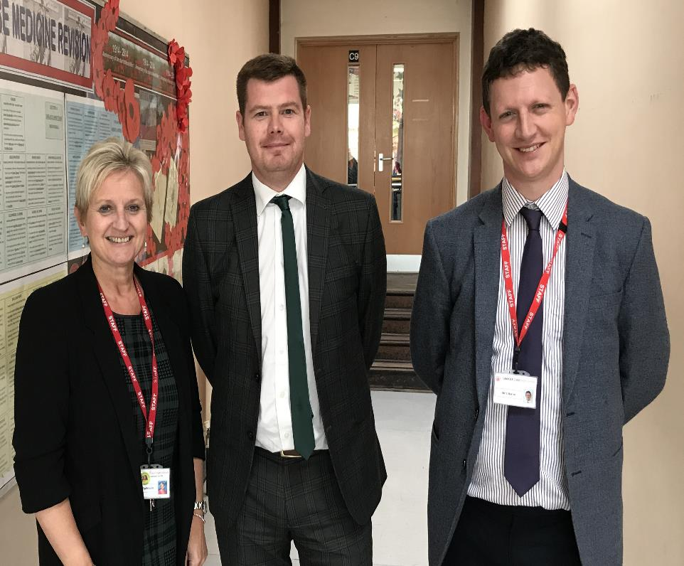
History Staff:
Mrs Spilsbury
(French Revolution)
Mr Doran
(Civil Rights)
Mr Byrne
(Britain & Independent Investigation)

Slide 3
What you can expect from staff
Experience
Engaging and innovative lessons
Enthusiasm
Work marked regularly with detailed feedback and comments to help you reach your target
To treat pupils as individuals, differentiation and use of intervention where appropriate
Good results!
100% Pass rate for the last 7 Years!
Around 90% A-C for 2018 & 2019

Slide 4
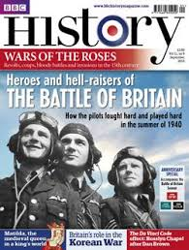
What we expect from students
Attendance
Enthusiasm!!!!!
Organisation
Contribution
Commitment
Ability to meet deadlines
Independent learners
Read around the subject

Slide 5
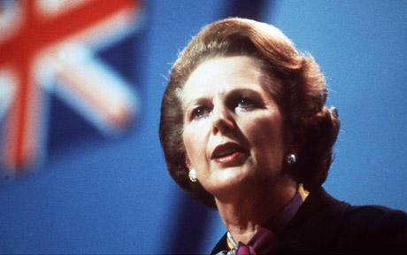
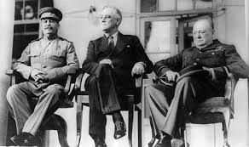
Post war Britain & Churchill enquiry
Churchill 1930-51
His view of the events between 1929–1940
His role as the wartime Prime Minister
His role in international diplomacy 1939–1951
Post War Britain
Conservative domination 1951-64
Labour and Conservative governments 1964–1979
Thatcher and the Conservatives 1979-1997
Britain’s position in the world 1951–1997

Slide 6
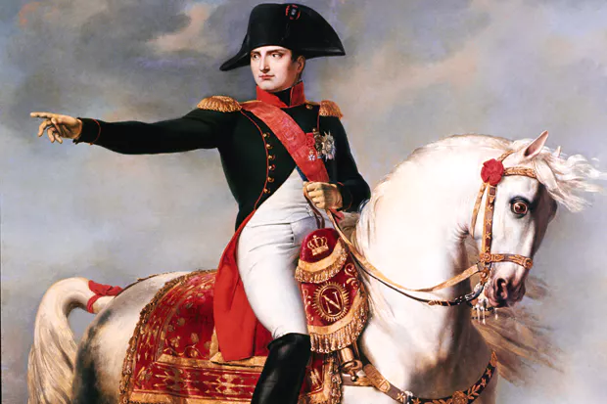
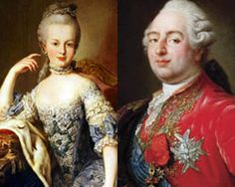
The French Revolution and the rule of Napoleon 1774–1815
The causes of the French Revolution from 1774
The events of 1789
The Revolution from October 1789 to the Directory 1795
Napoleon Bonaparte to 1807
The decline and fall of Napoleon 1807–1815

Slide 7
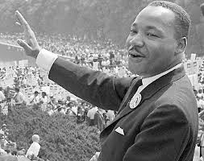
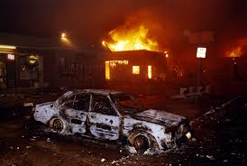
Civil Rights in the USA 1865-1992
This unit looks at the fight for social, economic, political and cultural equality for four different groups of people in America.
We study the struggle for:
African Americans
Trade Unions
Native American Indians
Women

Slide 8
Independent Investigation- The Final Solution
Students will be required to complete an independent investigation of 3,000-4,000 words which will be worth 20% of their final grade.
They will be expected to demonstrate evidence of reading widely around the subject, an understanding of debates and evaluating evidence.
This will not be a fully taught unit and students will have to show a good level of independent study.

Slide 9
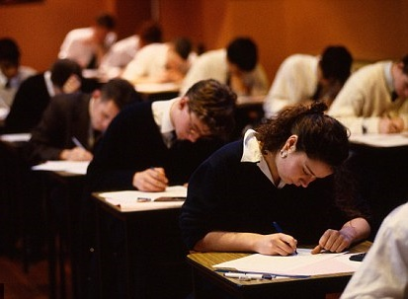
Assessment
A Level
Post war Britain & Churchill enquiry
1 hour 30 minutes exam
25%
The French Revolution 1774–1815
1 hour exam
15%
Civil Rights in the USA 1865-1992
2 hours 30 minutes exam
40%
Independent Investigation
3,000 – 4,000 word essay
20%

Slide 10
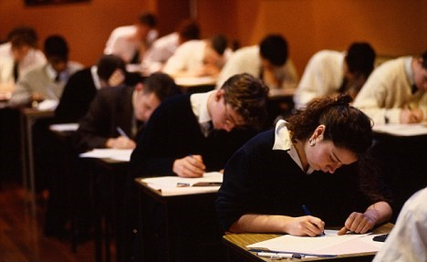
Assessment
There will be a combination of compulsory questions and an element of choice.
Students will be required to complete essay style questions
You will need to demonstrate skills in source and interpretation evaluation.
Students will be expected to interpret and evaluate primary and secondary material.

Slide 11
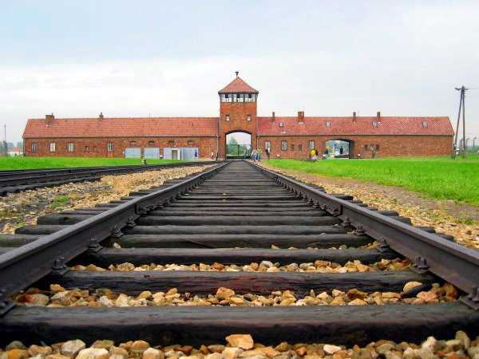
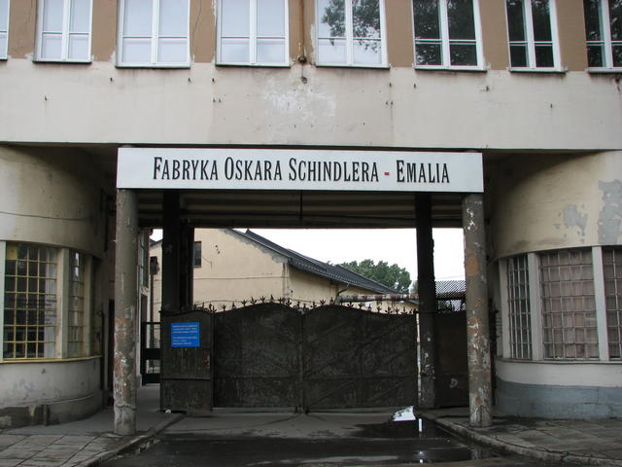
Krakow Trip
We are running a biennial trip to Krakow to visit a range of Holocaust museums which started in 2018 and is running in July 2020.
This includes visits to the Auschwitz concentration camps, Oscar Schindler’s factory and a tour of Krakow.

Slide 12
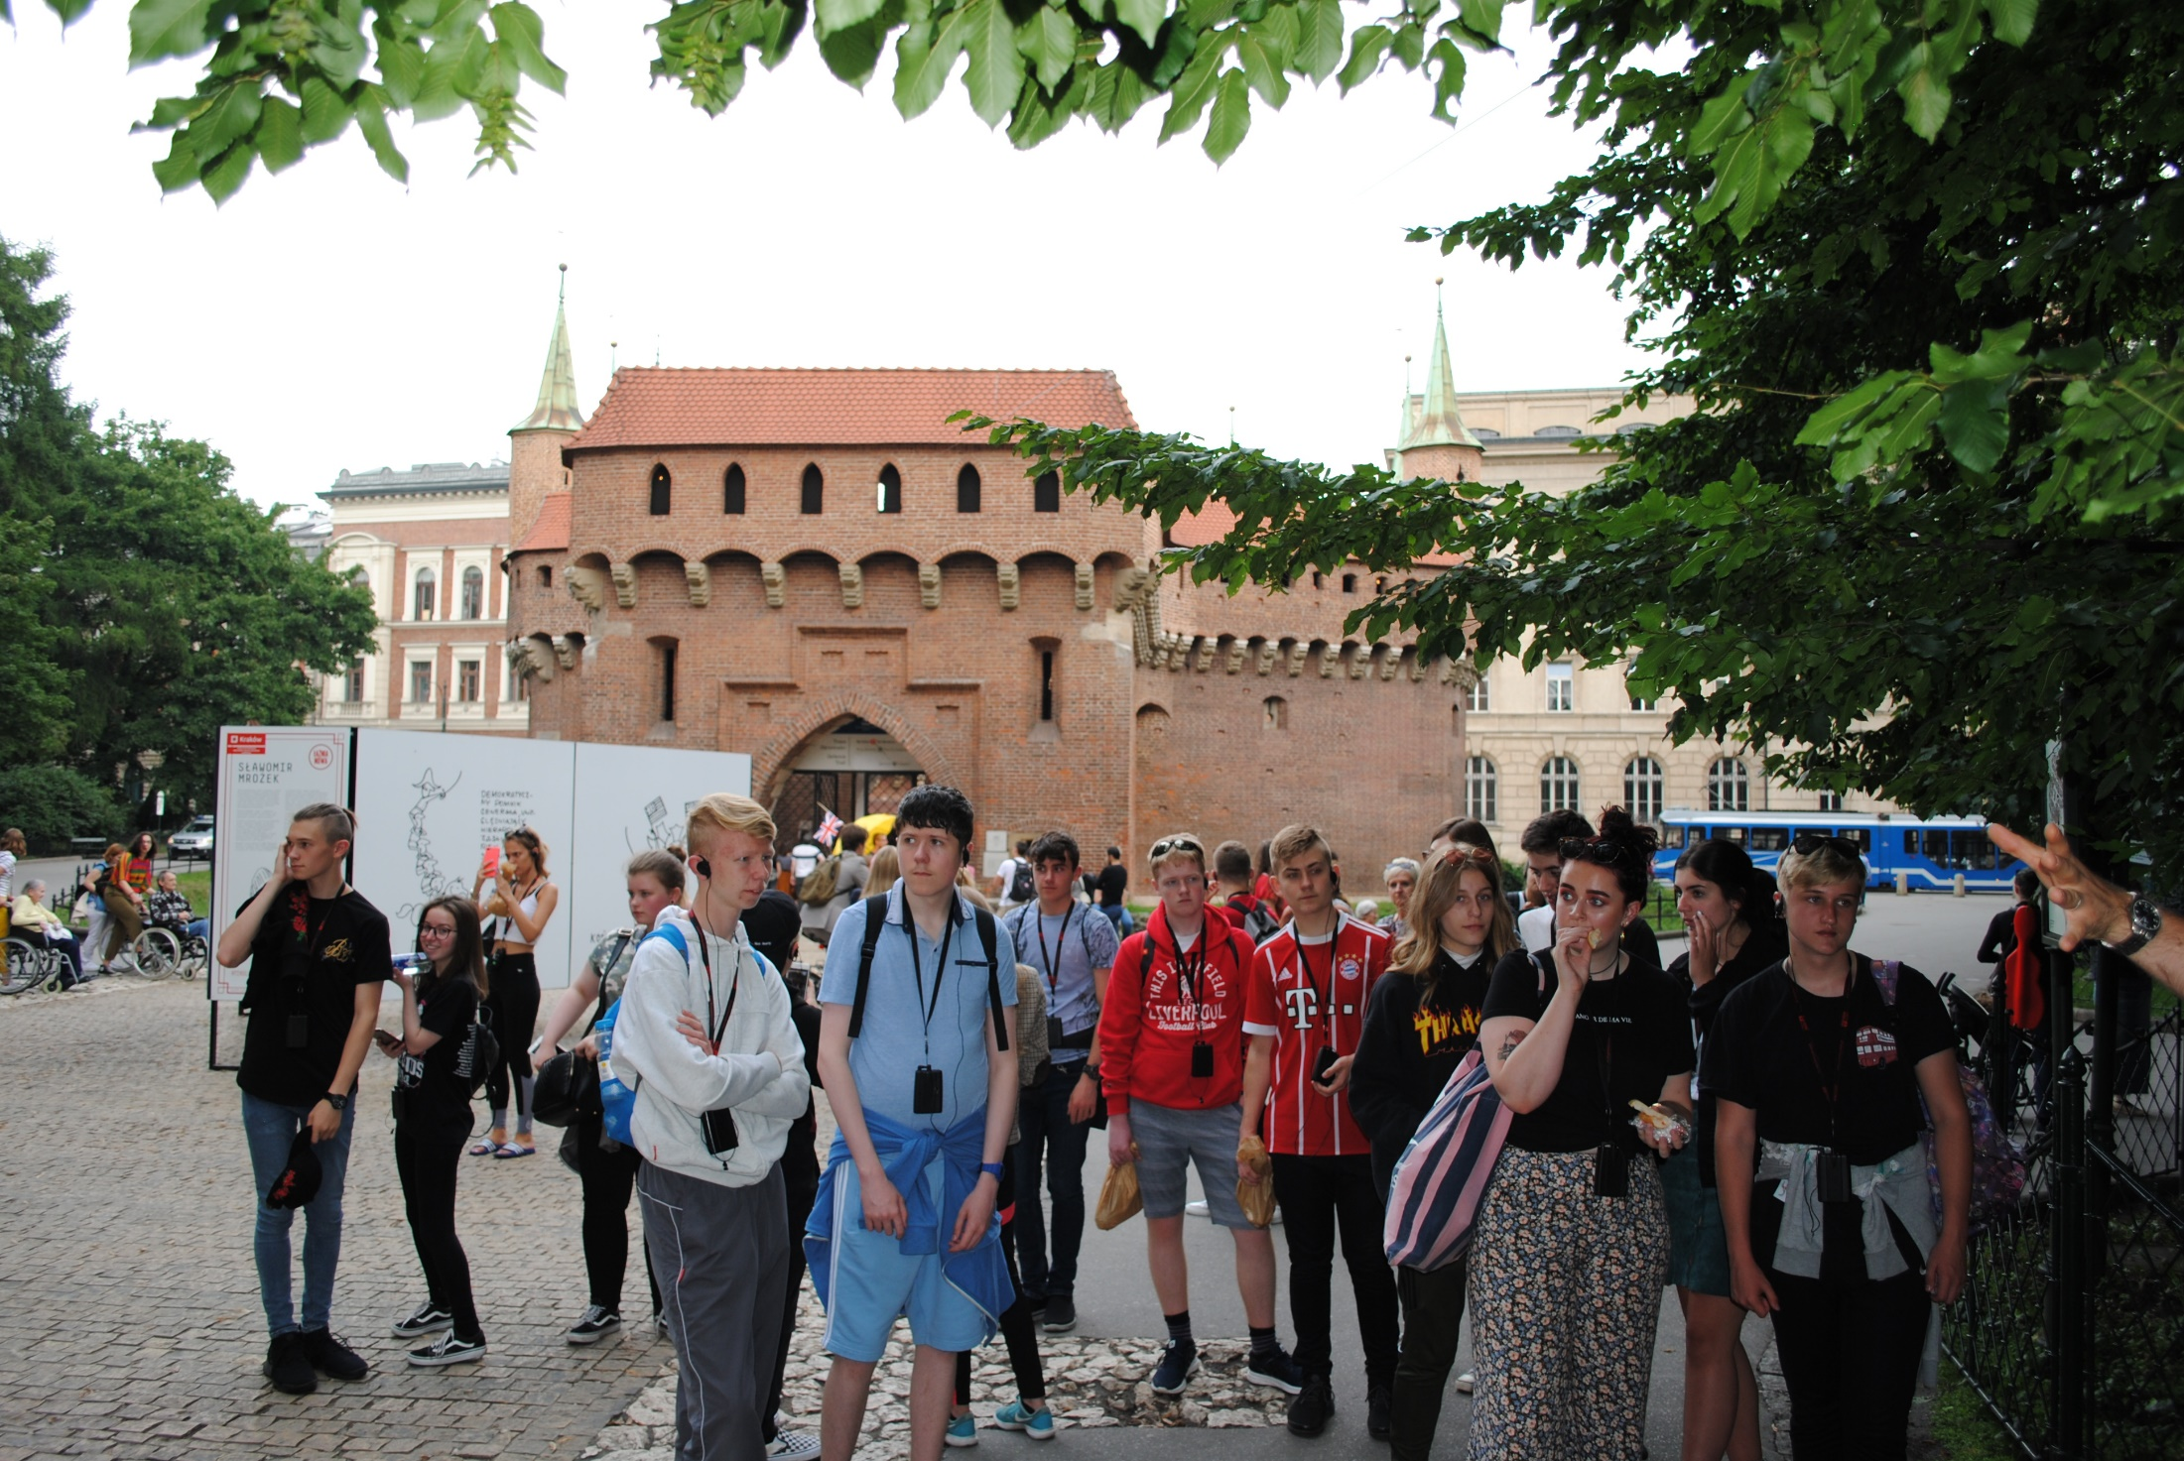
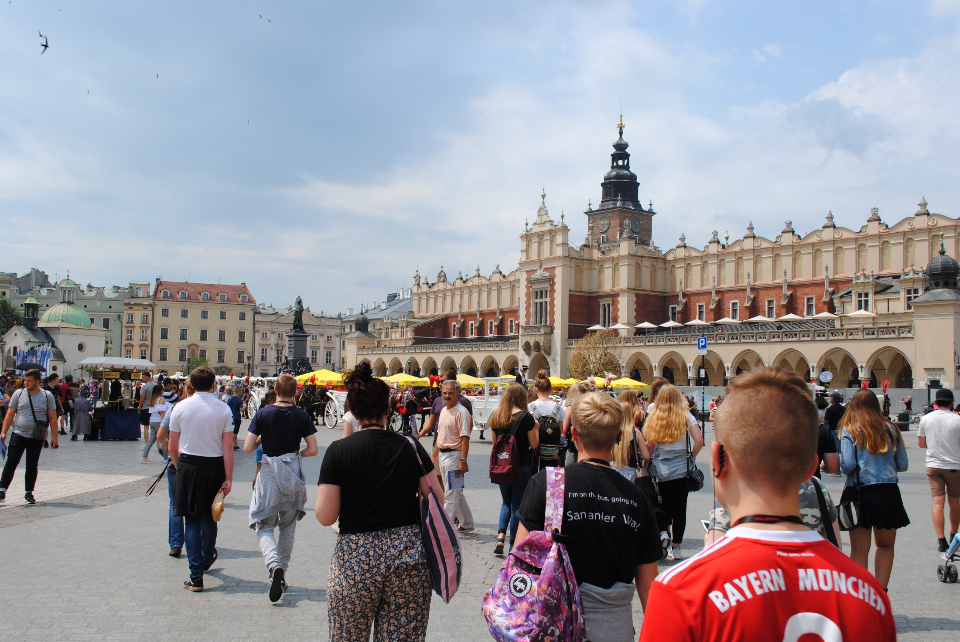
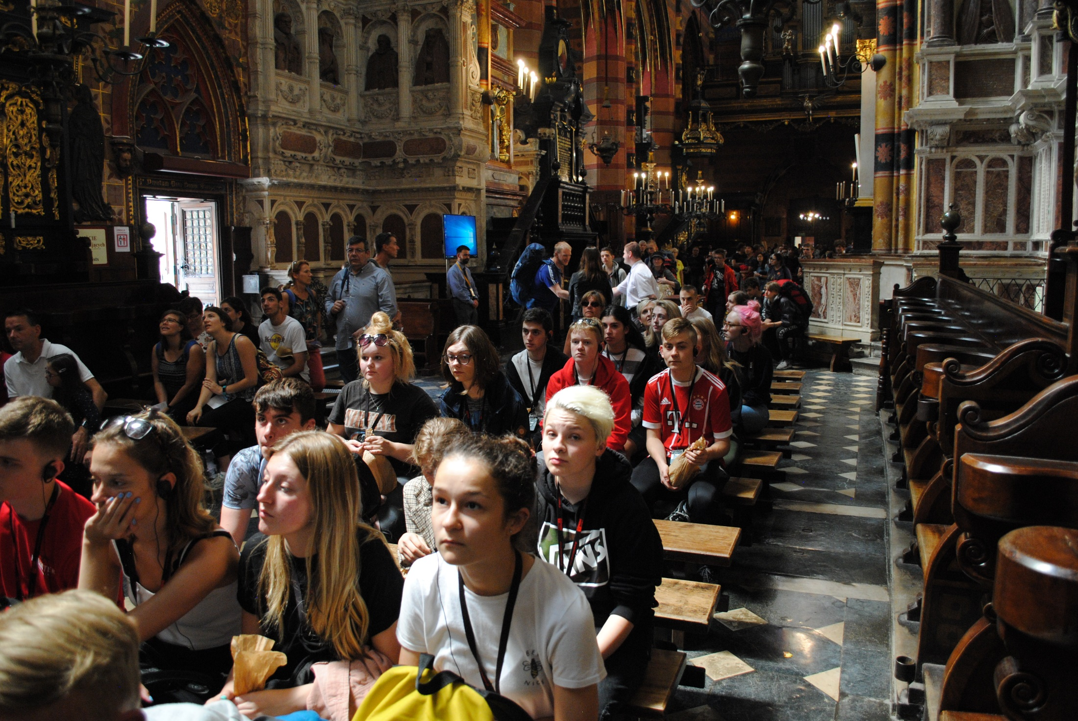
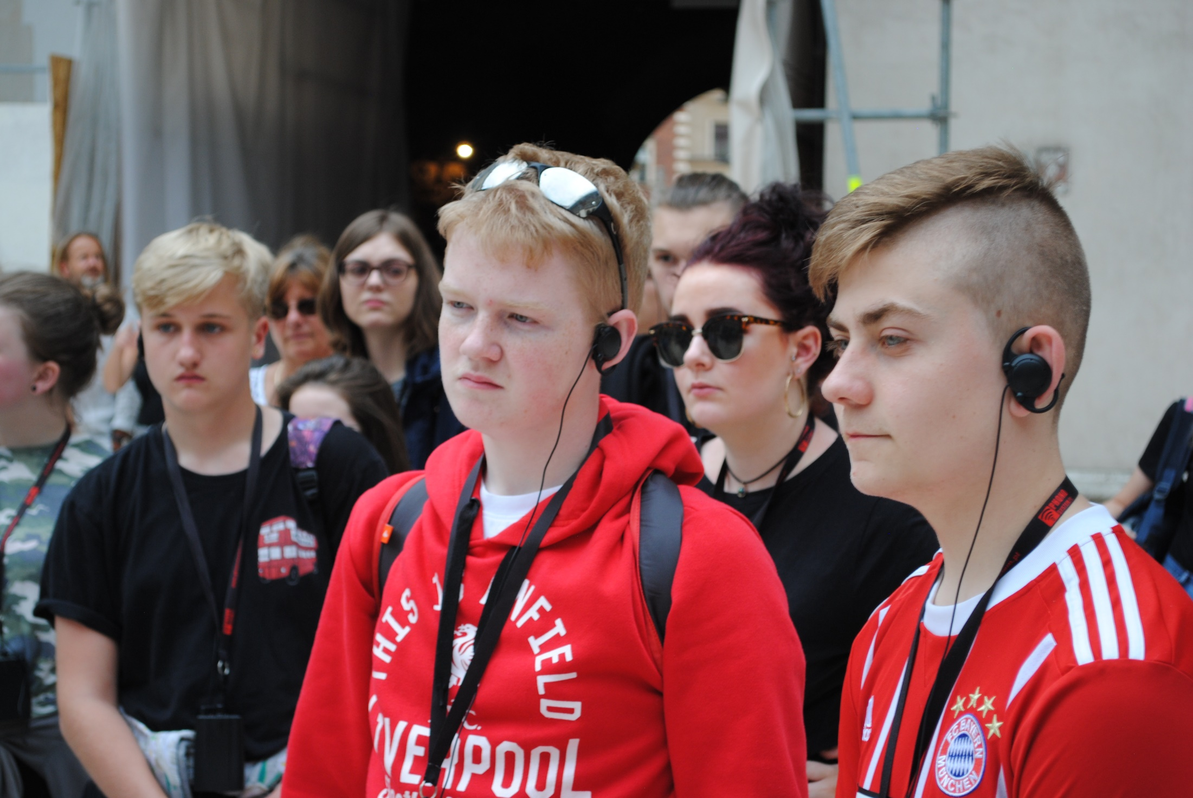
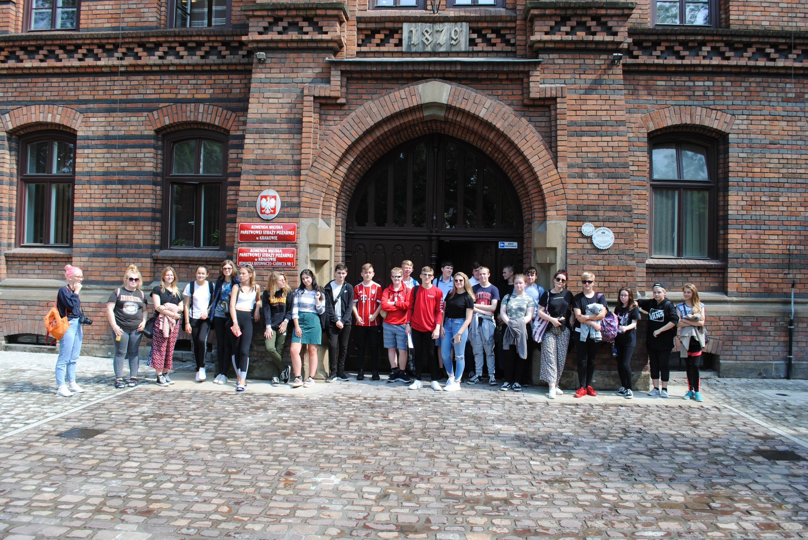
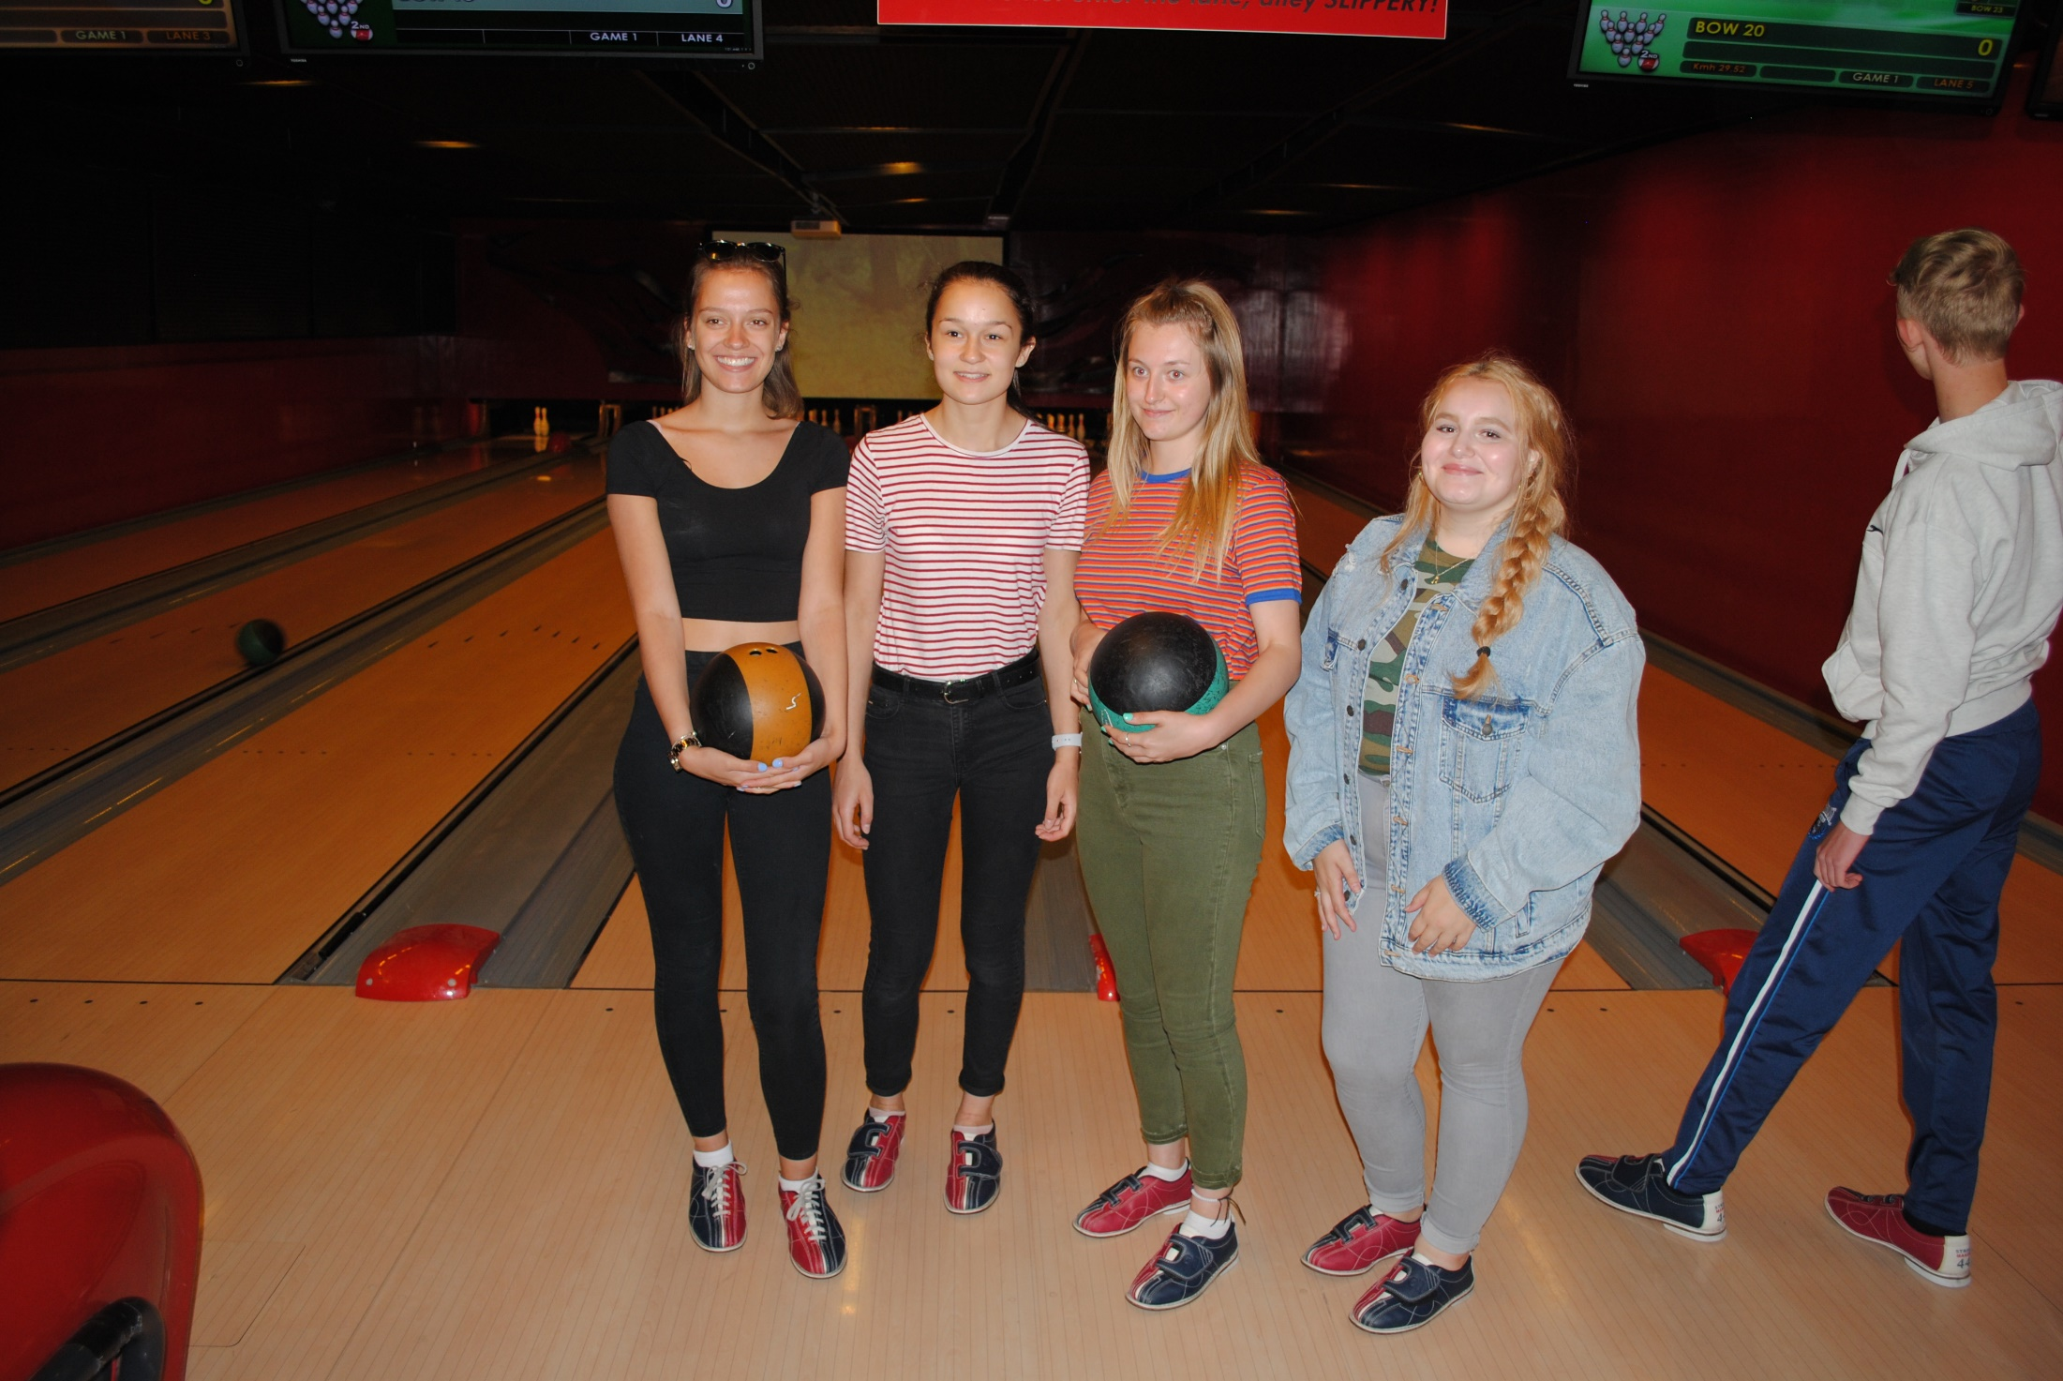
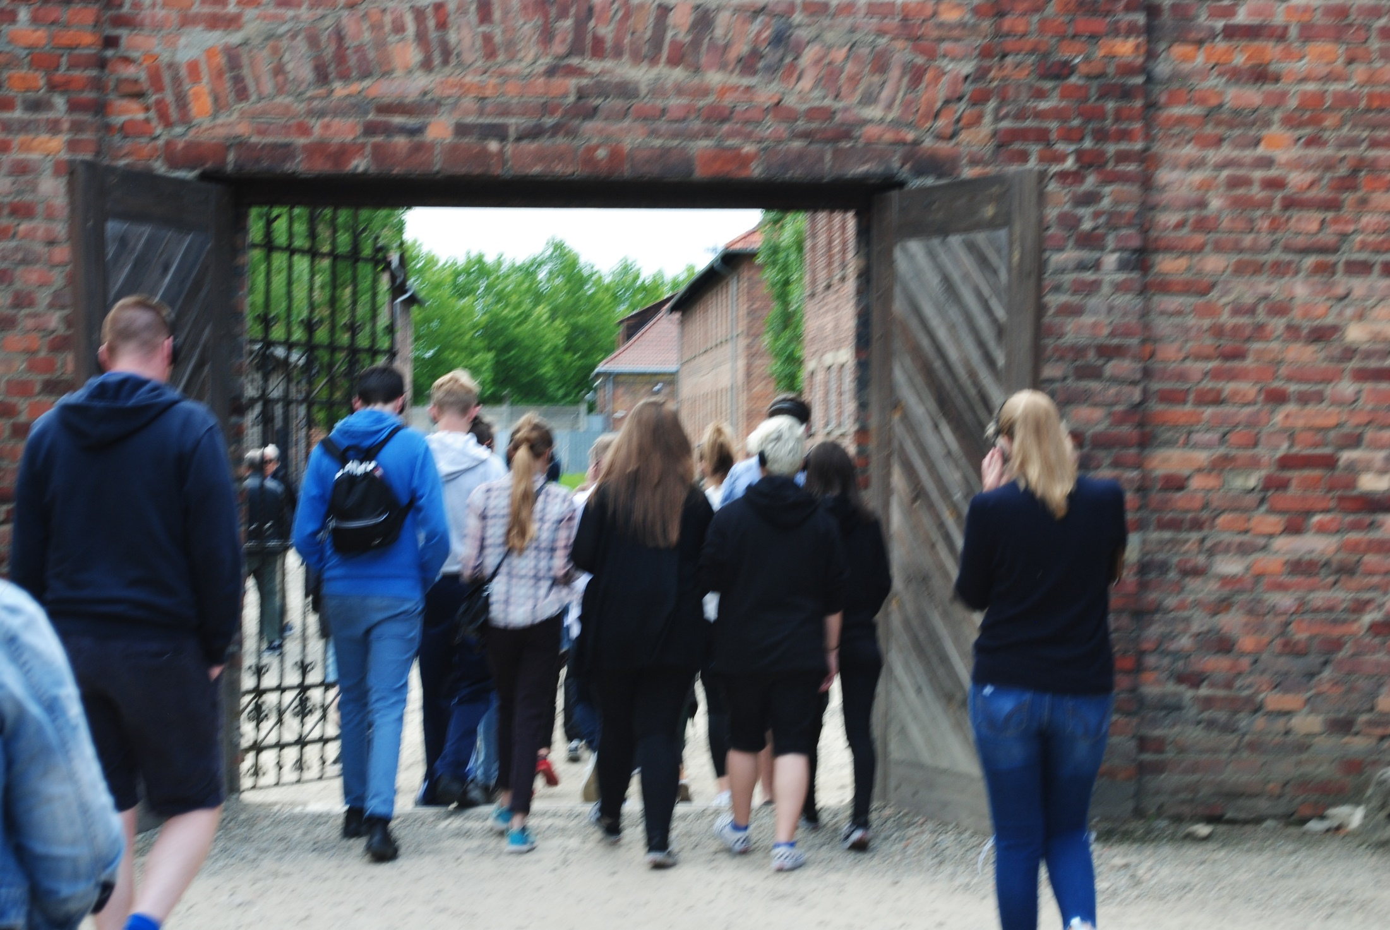
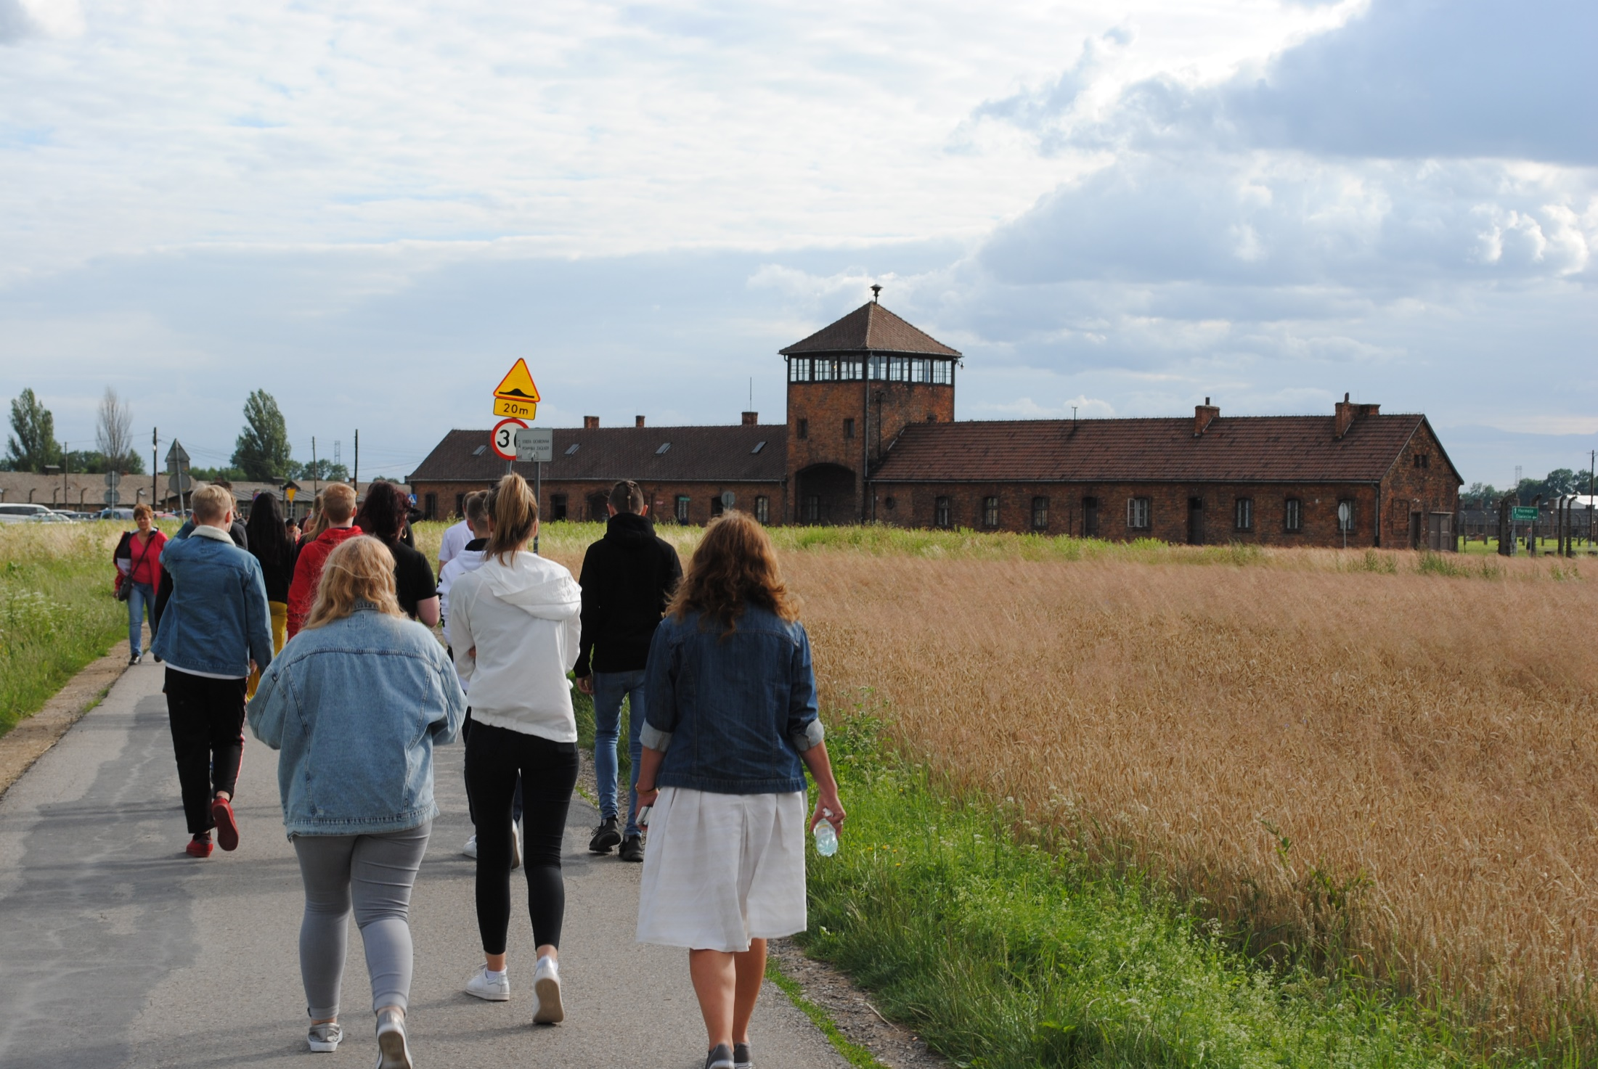
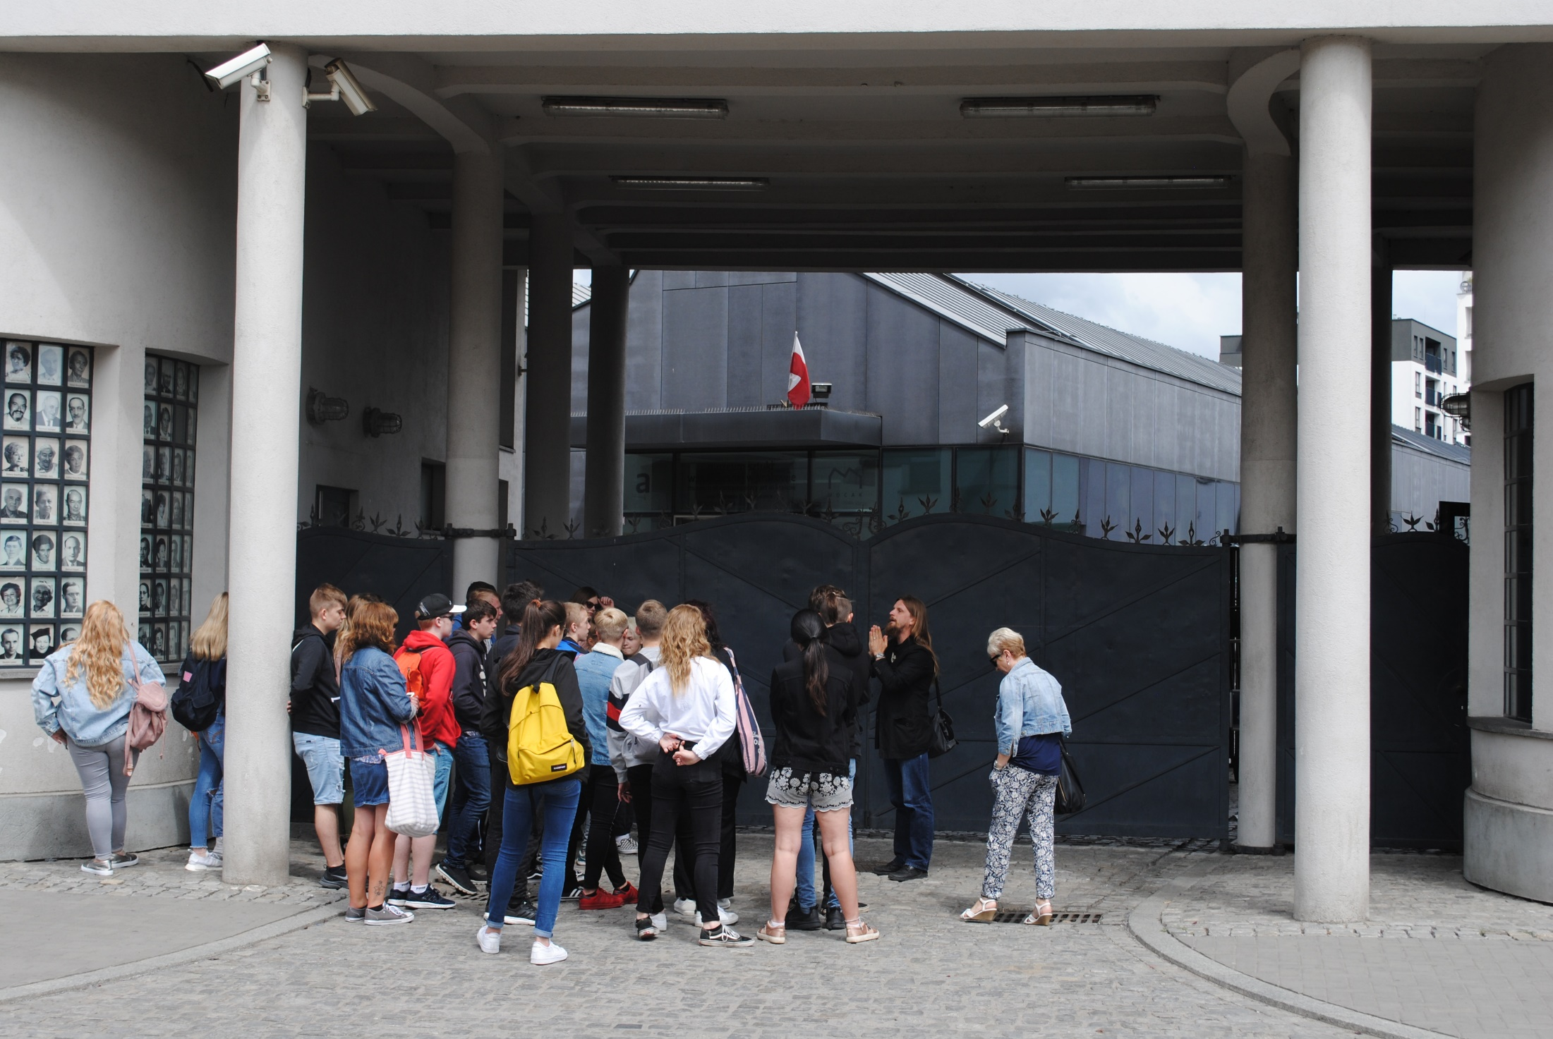
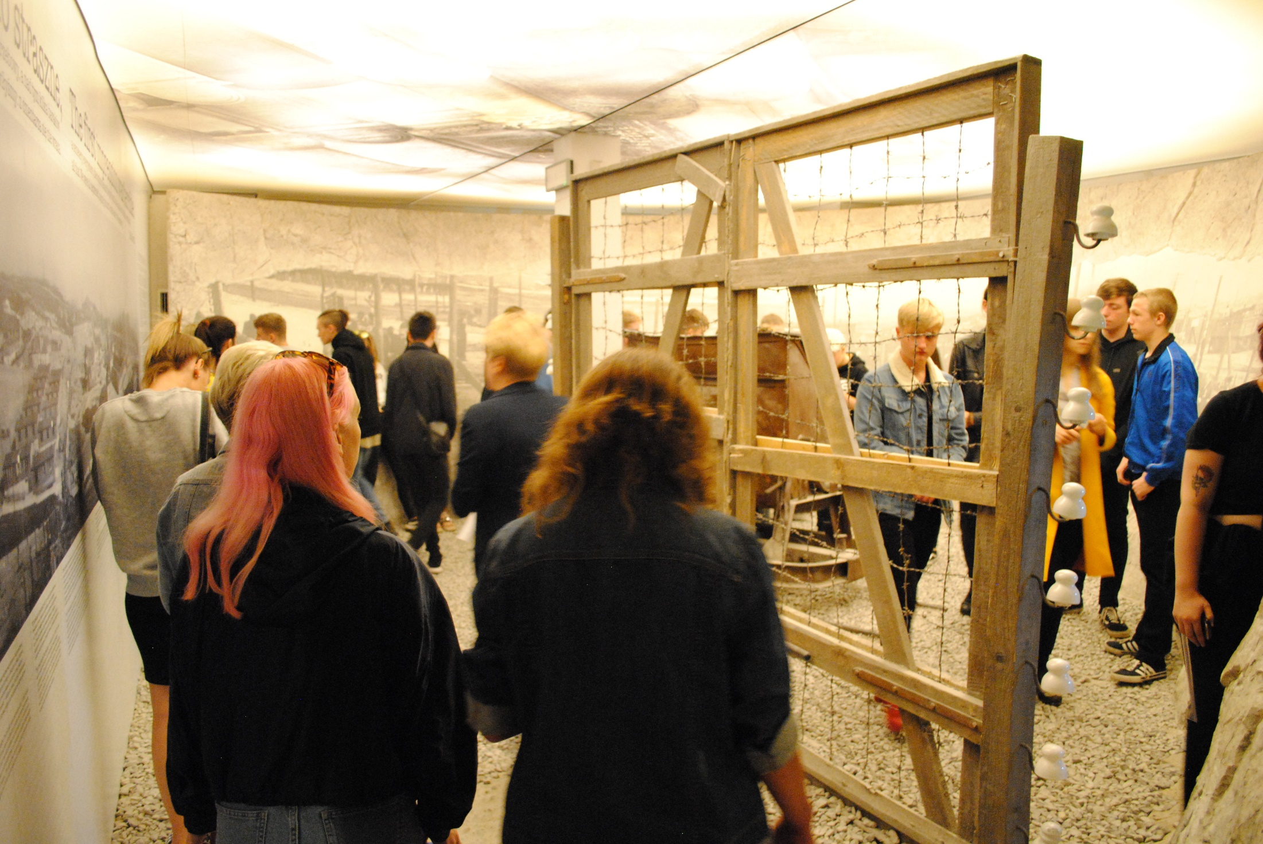
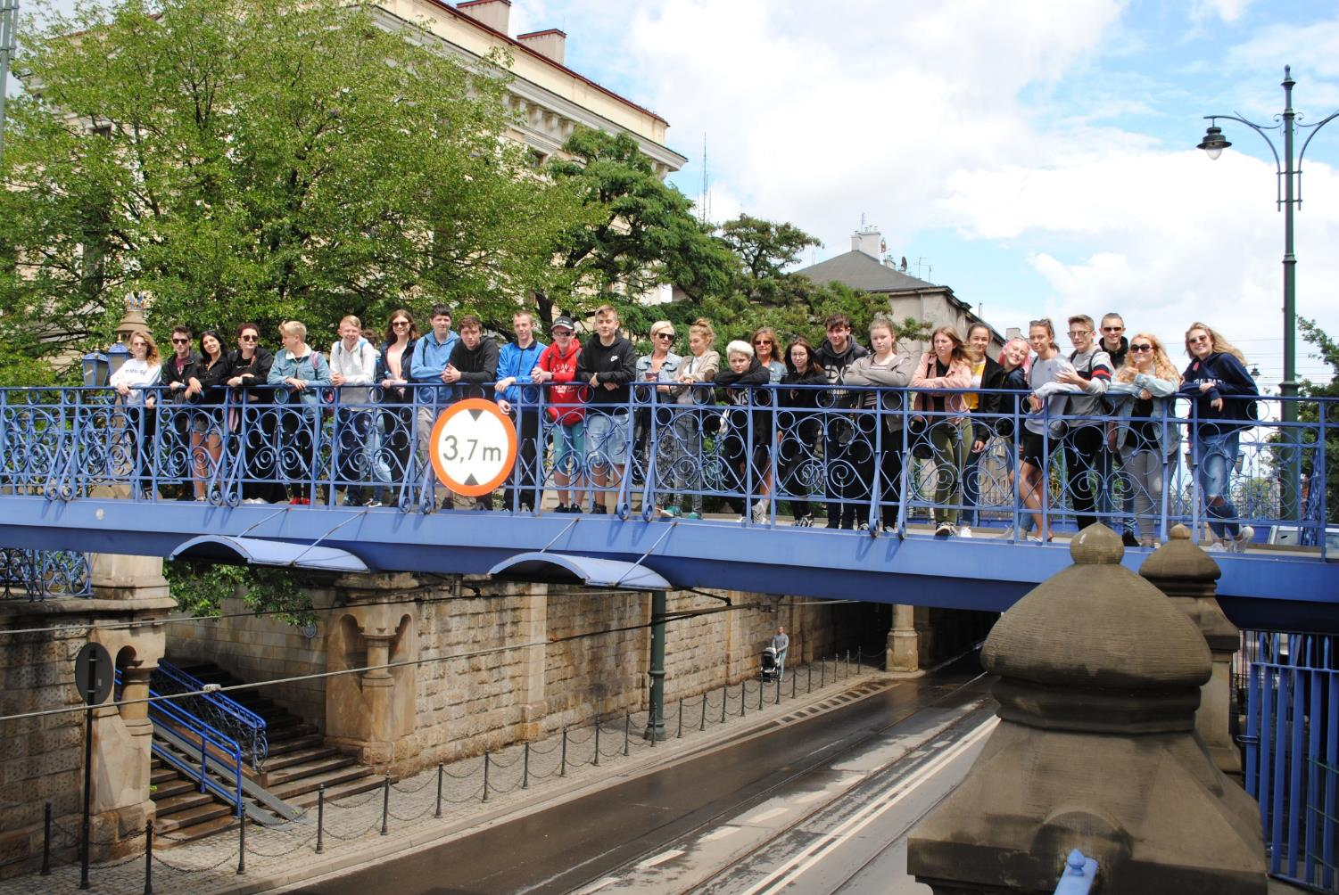

Slide 13
What skills will you gain by studying History at A-Level / beyond?
Communicating effectively:
Report-writing skills
Building and presenting a logical argument
Breaking problems down and suggesting solutions:
Asking (and answering) questions
Creating theories and backing them up with evidence
Managing (often lots of) information
Reflect on your own learning and performance:
Thinking critically
Work well with others:
Cultural awareness
Self-confidence

Slide 14
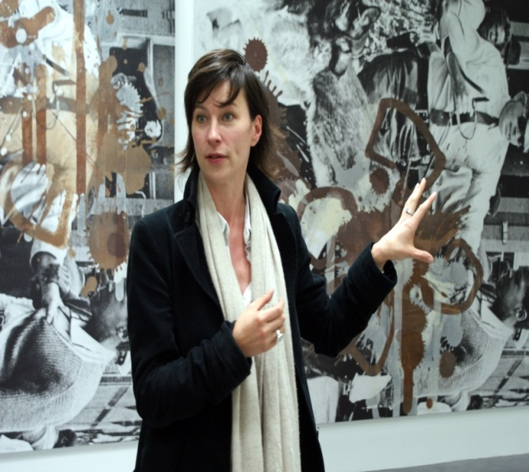
History teacher
Museum Curator
Librarian
…but I don’t want to do any of those jobs!

Slide 15
So…where have these skills taken others?
Law
Journalism
Broadcasting
Civil Service
Teaching
Police
Publishing
Recruitment
Banking
Management
Social Work
Insurance
Accountancy
Archaeology
Architecture
Restoration
Conservation
Property management
Museum curation
Heritage work
The armed forces
Politics
Consulting
TV production
Performing arts
Universities
The diplomatic service
Archivist
Records management
Trade unions
Public relations
Sales
Genealogy
The skills learnt are very versatile!

