Slide 1
6th Form Geography
GEOGRAPHERS
MAKE
A WORLD
OF DIFFERENCE

Slide 2
Geography in the News
How many of these news stories are to do with Geography?

Slide 3
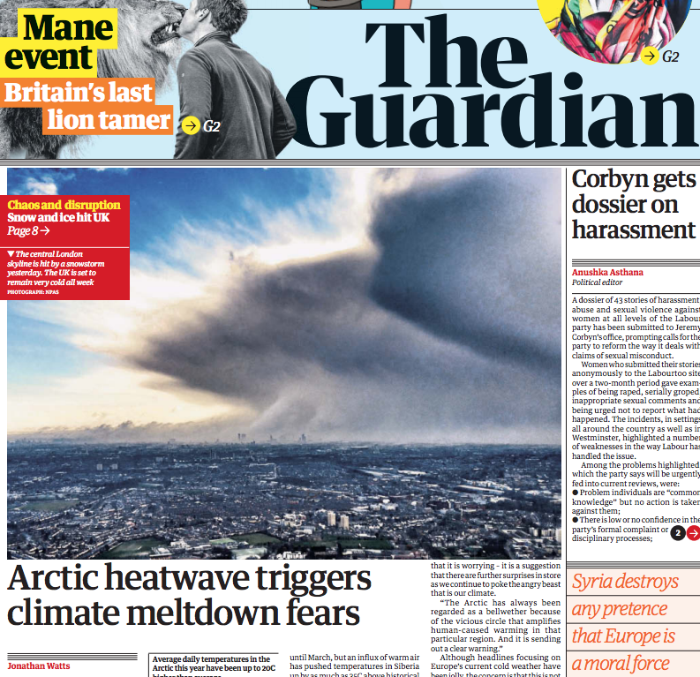
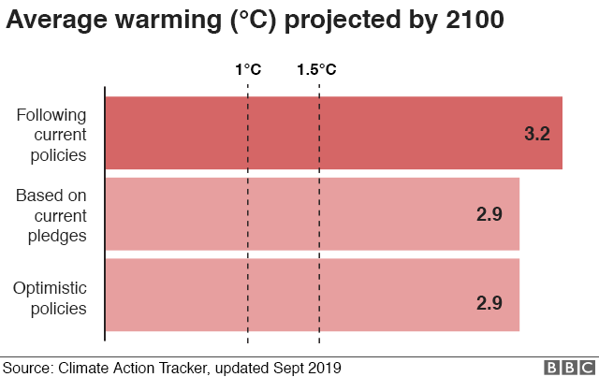
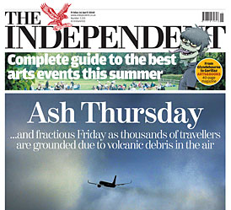
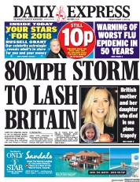
How many of these news stories are to do with Geography?
Notes:
Get them to do this as a little activity. Give out print outs of this sheet in colour.

Slide 4
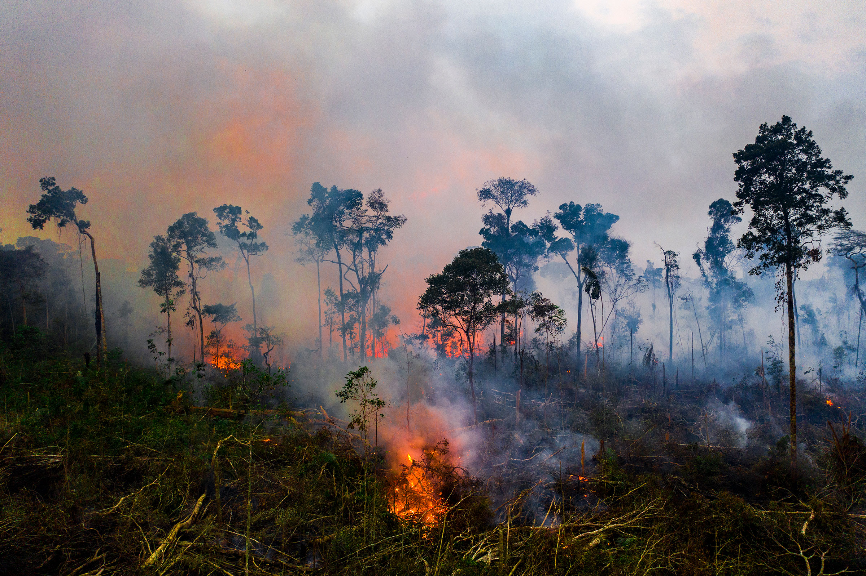
SO WHAT’S IT ALL ABOUT? Mission statement
GEOGRAPHY…
IS AT
THE FOREFRONT
OF
POLITICS AND MEDIA
The World is a BIG
place with countries
more interlinked than
ever before.
We need
to produce learners of
today that understand
the BIG picture!

Slide 5
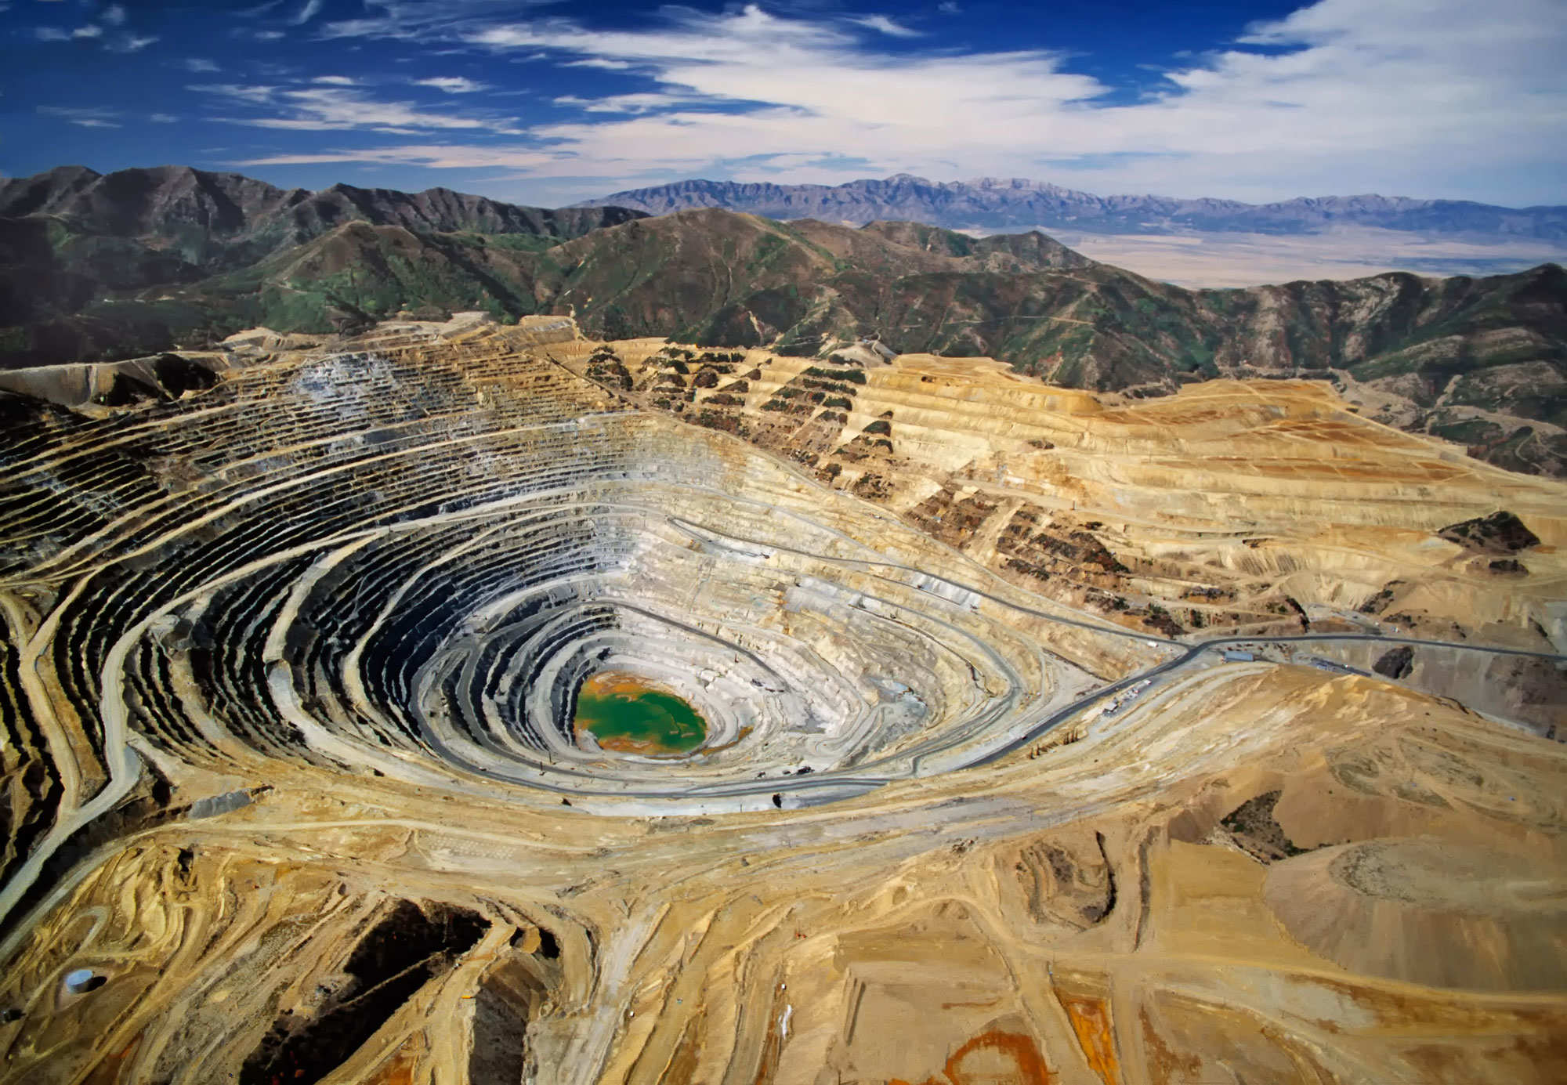
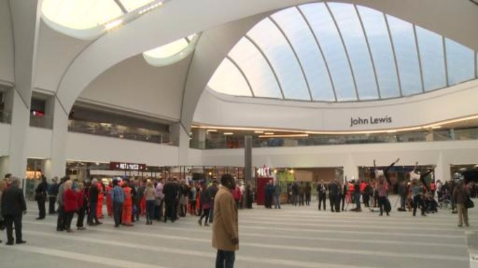
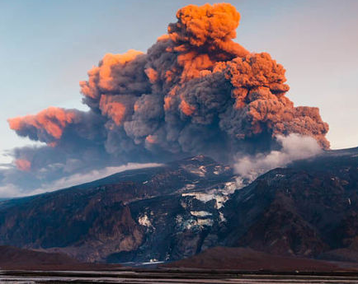
What will I study?
Year 12 | Year 13
Hazards Water and Carbon Cycles Resource Security Changing Places | Coasts Global Systems and Global Governance
Coursework
Notes:
Just some of the info covered in the carbon unit. Go through slide and show either video. (If you show the bbc news one, link it to current affairs, being able to watch the news and understand it . Geography is at the forefront of the news and the media, If you watch the u tube one, you will need to explain what it shows about climate change and why the Paris conference in the news this week is necessary.

Slide 6
A LEVEL GEOGRAPHY
Year 12
Physical Geography
Water and Carbon Cycles
Including distribution, processes and Global Warming. Is it a new thing, what will happen, fact or fiction, how should we tackle it?
Hazards
A study of hazards, the physical processes which form these distinctive landscapes and the impact of human activity on these landscapes.
Year 13
Physical Geography
Coasts
The physical processes which form these distinctive landscapes and the impact of human activity on these landscapes.
Human Geography
Global Systems and Global Governance
Connectivity between people, places and environments across the globe. Globalisation – the economic, political and social changes associated with globalisation and a place study of Antarctica including governance, threats and protection.
Human Geography
Resource Security
Focus on large scale exploitation of natural resources such as water, energy and minerals. This examines the links between human and physical processes and includes link to sustainability and conflict.
Changing Places
Growth of certain places, and the regeneration projects that have rebranded them.
Fieldwork
Students are required to attend a compulsory fieldtrip. Four days of fieldwork must be completed throughout the two years of A Level
Fieldwork is assessed by an independent investigation. 3000-4000 words. (20%)
Geographers make a WORLD of difference.
Notes:
Give out hand out and go through in a non comital fashion!
Two papers-one human and one physical. Fieldwork integrated within the paper, asked about what they did and what they found out.

Slide 7
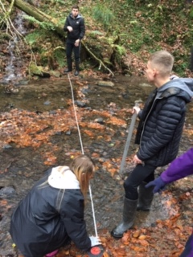
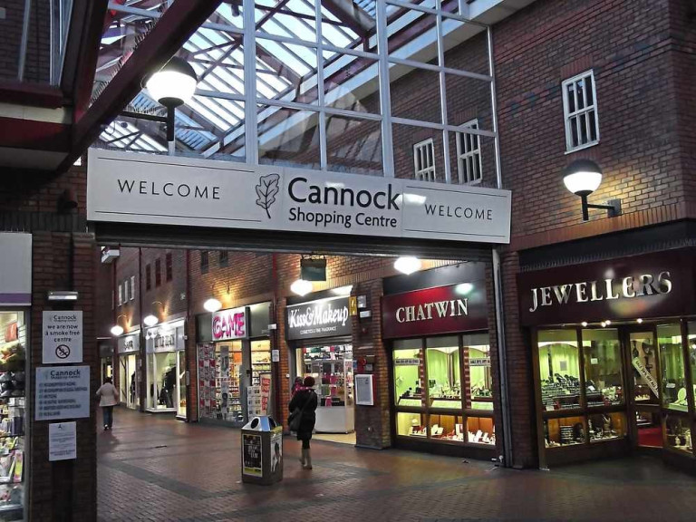
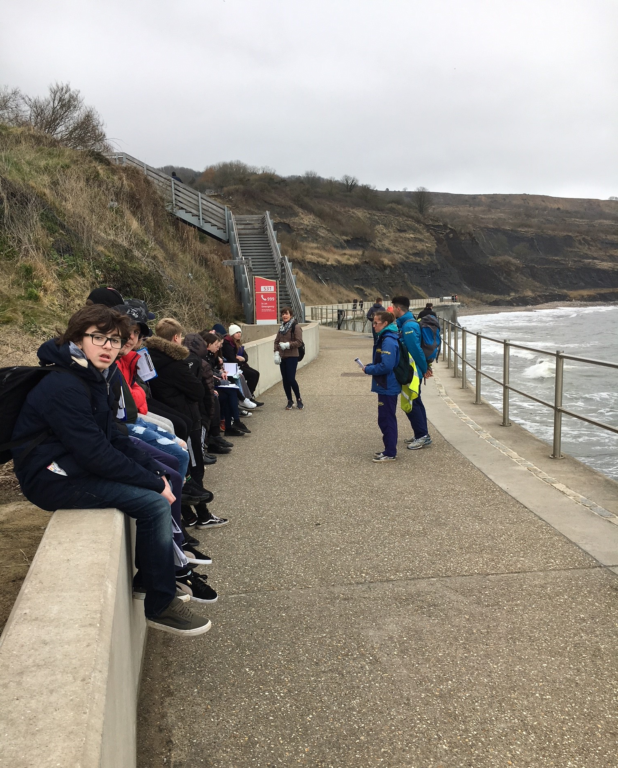
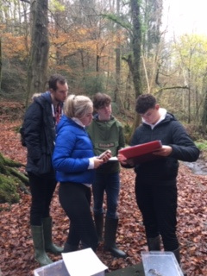
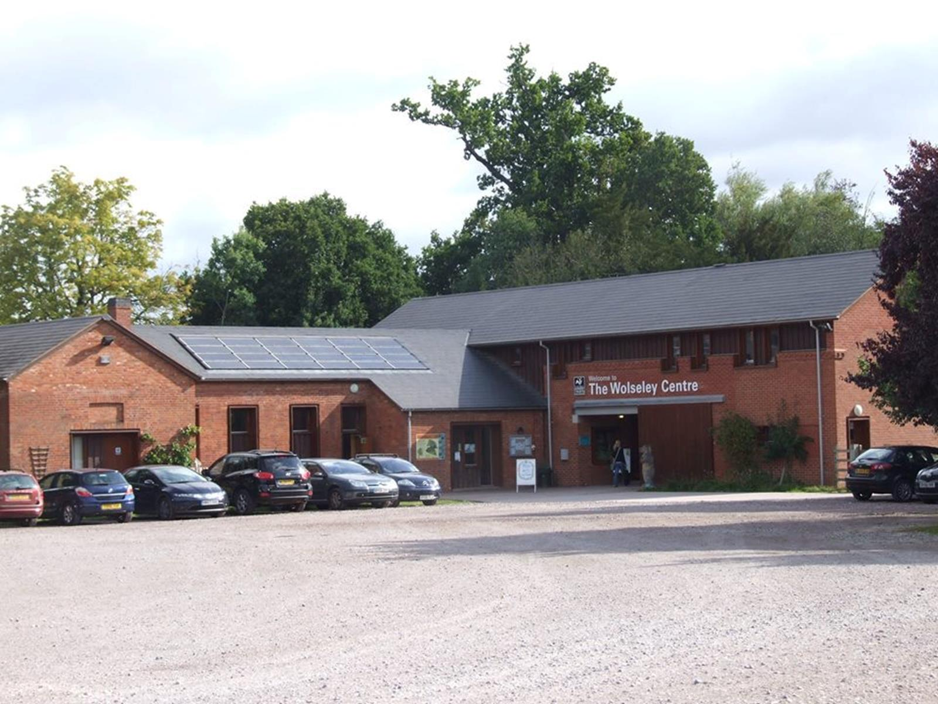
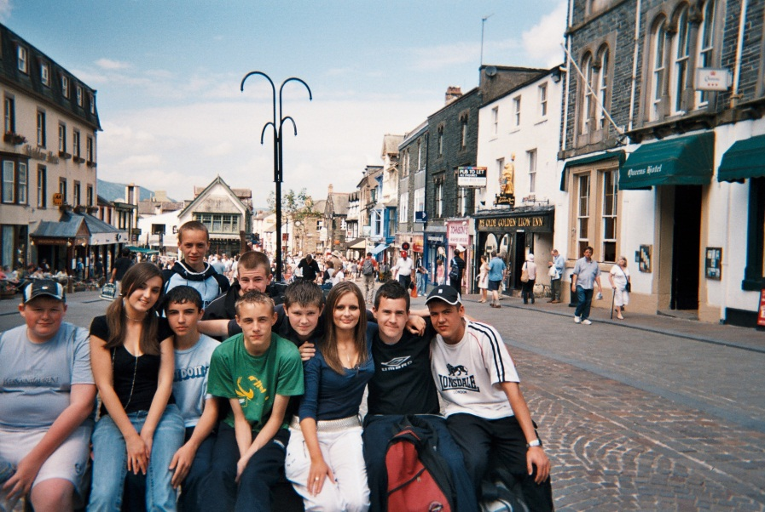
Fieldwork…..
2 individual days at AS (One human and one physical)
2 days at A2 (with potential for a residential trip) to complete independent study (20%)
Notes:
The stuff legends are made of… the very best bit, memories will stay with you for years. Still remember my own fieldwork. Certainly character building we’ve been in the Cumbrian floods and been snowed in, in Somerset, gale force winds in Cumbria, so much so it blew one students trousers down to his ankles, students (male 6th former) crying in Yorkshire and wearing yellow rubber gloves as his hands were so cold and students wearing bin bags in a minibus on the way home from Blackpool as the rain even managed to soak through their waterproofs through while doing fieldwork in the sand dunes.

Slide 8
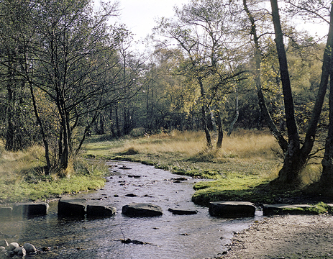
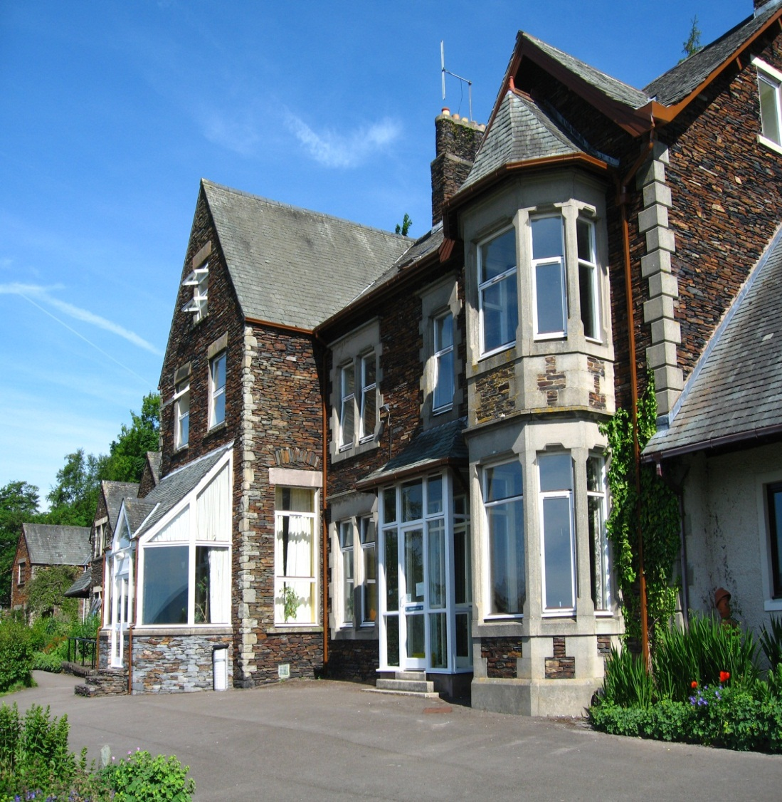
A LEVEL GEOGRAPHY Fieldwork
( the best bit of Geography, the stuff legends are made of!)
WHEN?
ALL students who study A Level Geography are required to take part in at least four days of fieldwork.
Year 12 (2 individual days)
One day in an urban location and one day in a physical location.
Year 13 (2 day visits – potential for residential)
WHAT?
Fieldwork is assessed by an independent investigation. 3000-4000 words. (20%)
Some of the individual days in Y12 will give students a deeper understanding of the local areas, needed for their case study in changing places.
WHERE?
Year 12: Current and planned fieldwork:
Hazards revision day, Manchester
Rivers field study, Cannock Chase
Changing use of areas, Birmingham
Year 13: Planned fieldwork:
Individual days used for data gathering in coursework
Residential field course to study coasts
Geographers make a WORLD of difference.
Notes:
Go through reverse of hand out

Slide 9
A SUCCESSFUL DEPARTMENT
“Geography consistently performs well at A Level”
100% A Level pass rate since 2005
100% of students achieved A*-A at A2 in 2018
100% of CCHS students achieved A-C at A2 in summer of 2019
100% A-D grades predicted for summer 2020
Our boasts!
Notes:
State that it will be predominantly taught by you (the kids will like this ☺)

Slide 10
Who is this course for?
Anyone who wants to be inspired
Like to know about the world we live in
Enjoy travel and finding out about places
Relish field work opportunities
Follow current affairs
Are not afraid to express their opinions
Like studying a subject that is relevant to their own lives and experiences
Enjoy using the latest
Geographical technology
Face up to a challenge
Want to be highly employable in many of tomorrows jobs
Wow!
Arrgh!
Ooh!
Ah!
Minimum entry grade 5 or above

Slide 11
Where can I go with Geography?
Students with A Level Geography have access to a wide range of possible career and higher education opportunities. You learn and use a variety of transferable skills throughout the course. These include collecting, analysing and interpreting data. The use of the GIS and ICT has strong vocational links and makes you highly employable.
These skills are in great demand and are recognised by employers, universities and colleges as being of great value.
Taken with sciences like mathematics, physics, chemistry and biology, geography supports applications for almost any science-based university course like engineering, environmental sciences, oceanography and geology; taken with humanities like English, French, history or economics, geography supports an equally wide range of university courses such as business, law, politics and media.
Because AS and A2 Geography develop the transferable skills and the Key Skills that employers are looking for, they can lead to a very wide range of employment opportunities. The qualification can also lead to further training in such areas as the law, accountancy and journalism
Employers know that students who study Geography have a well rounded and broad knowledge base
Notes:
Stress that its more the point, Where can’t you go with Geography.’ Such a broad skills base that you can go as far as you want with it. Highly demanded by industry, as know well grounded with good knowledge of current affairs and broad skills and knowledge base. If you are good at Maths/ Science some extremely lucrative jobs working for multi national companies such as BP etc that you can work overseas with- Geophysics, Geoengineering- not affected by recession as renewables is a growth sector. We even have one ex student who is currently completing his degree in meteorology at Reading with a view to becoming a BBC weather man and he’ll do it! Watch this space!

Slide 12
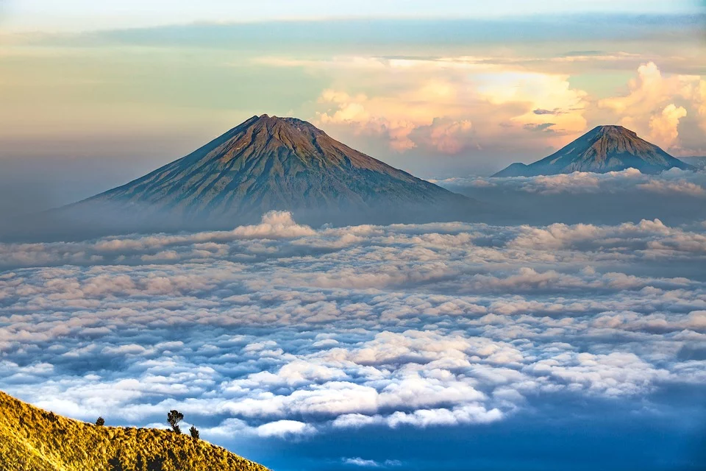
Not convinced yet?

