Slide 1
Further Mathematics A Level
Sixth Form Open Evening

Slide 2

Requirements
To be able to enroll onto A level Further Mathematics you need:
Grade 7-9 GCSE Mathematics
Followed the Higher syllabus
Have a love for the subject
Hard work ethic
Desirable
Need it for your future career and want to continue to study Mathematics at university.
Just enjoy doing Mathematics

Slide 3
Content
Year 12 | Year 13 - A Level
Core Pure Mathematics 1 | Paper 1: Core Pure Mathematics 1
Decision Mathematics 1 | Paper 2: Core Pure Mathematics 2
 | Paper 3: Decision Maths
 | Paper 4: Further Mechanics

Slide 4
Important Facts
You must do A Level Mathematics to do A Level Further Mathematics.
Some overlap between Maths and Further Maths in some modules – doing Further Maths will benefit Mathematics.
NO COURSEWORK – all exam based.

Slide 5
Important Facts
All papers are with a calculator. You will need a more advanced calculator
Casio fx991-EX is the minimum requirement
NO COURSEWORK – all exam based.
A level Further Mathematics has a 50:50 between pure to applied content*.
*applied maths will be decision and mechanics

Slide 6
How is Y12 and Y13 delivered?
All content is delivered during 5 lessons per week.
Students will have two teachers. One for 3 lessons (who will teach the pure content and some applied) and the other for 2 lessons (who will teach the rest of the applied content).
*applied maths will be decision and mechanics

Slide 7
Assessment
Students are assessed via chapter tests and also progress check assessments once every term.
Students should expect to receive homework every week.
Independent study is also expected and students should each have their own independent study folder which is checked regularly.

Slide 8
Reasons to study further mathematics
“Maths skills are in high demand – meaning that people with the right qualifications will not only be able to command a high salary, they will also have a lot of choices in the job market, meaning that they can have the ability to find a job which suits them and interests them.”
“Almost 30 per cent of skill shortage vacancies in 2015 were linked to a lack of ‘complex’ numerical/statistical skills.”

Slide 9
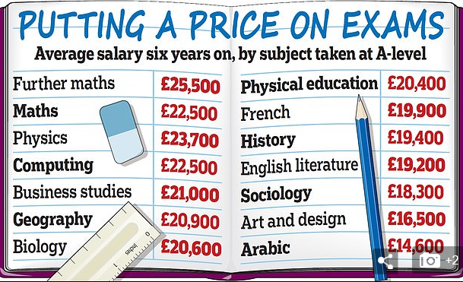
Reasons to study further mathematics
The figures, from the Department for Education, draw on tax data to reveal what people in England who took their A-levels in 2010/11 were earning in 2016/17.

Slide 10
Summary
Must have at least a Grade 7 at GCSE Higher Tier – for those who are exceptionally good at Mathematics.
Hard work and perseverance is necessary, but worth it in the end!
Regular attendance at lessons is essential.
A well thought-of A Level which is ideally suited to those who are thinking of studying Mathematics at university – although not an essential entry requirement.

Slide 11
Questions
Questions?

