Slide 1
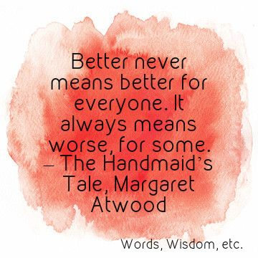
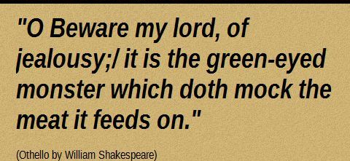
English Literature at Cannock Chase High School

Slide 2
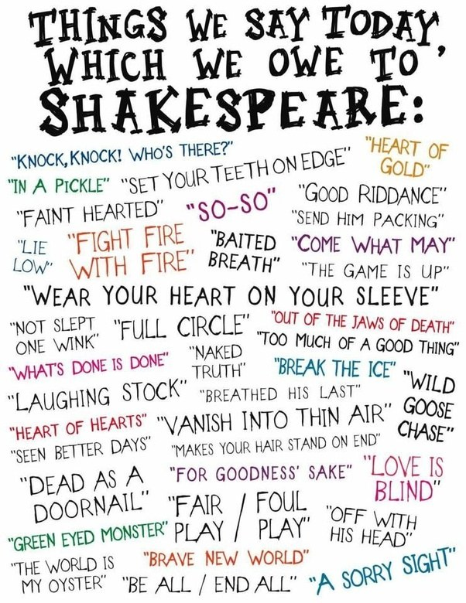
Who knew that we would owe so much to Shakespeare?

Slide 3
Did you expect the following to be things that we discuss in English Literature?
Some of our more recent topics:
Donald Trump’s climb to power was inevitable.
Society will never be equal.
What would happen if a Miley Cyrus concert video was the one thing saved from our generation?
Is love always linked to money? Can you be wealthy and fall in love?

Slide 4
Where can English Literature take me?
A qualification in English Literature can show future employers that you can analyse, discuss theories, write essays and present arguments. It is not just about reading!
Teaching
Law
Journalism
Author
Publishing
Editor
Business
Public relations
MANY more!

Slide 5
Results
100% A*-E
A number of our students go on to study English at University or an English based qualification.

Slide 6
You are in an amazing position!
In previous years, the ‘jump’ to AS from GCSE seemed quite significant in English Literature because Year 11 had included 25% coursework and less quotations to learn.
You are in a much better position because you are already in the habit of learning quotations.
You will be able to take the books in to your A Level exams!

Slide 7
Why should you choose to study English Literature?
I like reading. (You will be expected to read outside of lessons).
I especially like to read different forms of literature.
My analytical skills are a strength.
I like to debate issues.
I enjoy exploring why a writer has chosen to produce a certain text.
I want to develop my ability to link texts across genres and time periods.
I am good at explaining the effects of words and phrases on the reader.

Slide 8
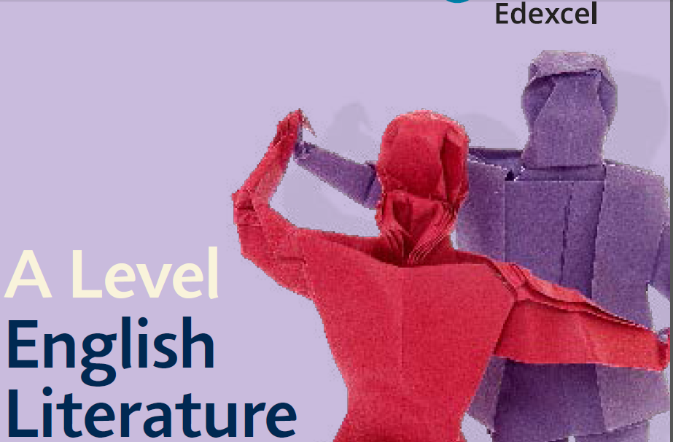
What will you study?
We follow the Edexcel course and it is structured over two years.

Slide 9
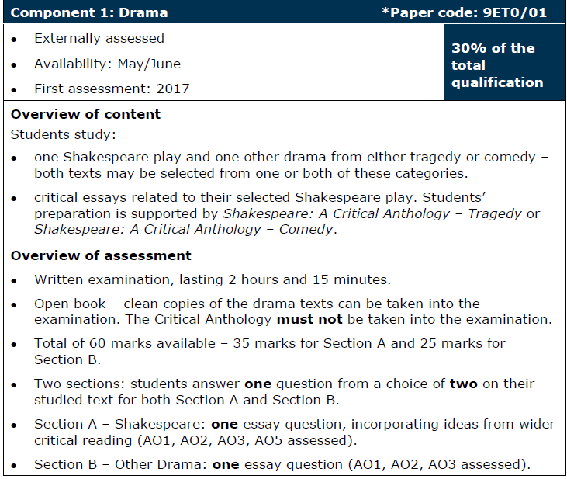
Othello
Streetcar Named Desire

Slide 10
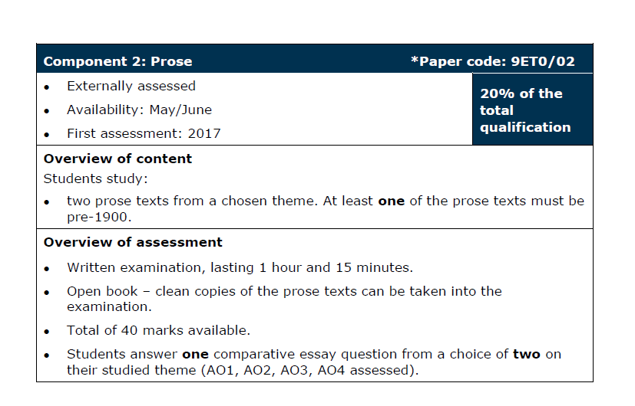
The Handmaid’s Tale by Margaret Atwood and Frankenstein by Mary Shelley.

Slide 11
Romantic Poetry Collection
Post 200 Poetry

Slide 12
Coursework that is worth 20%
You can choose your texts.

Slide 13
Our previous students have voiced their thoughts:
I took English Literature as I loved to analyse books and poems and explore different layers of meaning. Now, in my second year of my Psychology degree, I can see what an important role English Literature played in developing my critical analysis. Whether writing a literature review or a lab report, being able to critically evaluate is vital to achieve at least a 2:1. I also believe, in general, that English Literature exposes you to a wealth of knowledge regarding different opinions and historical information that is useful in all aspects of a degree.

Slide 14
English Literature was definitely the A Level I enjoyed most whilst at Sixth Form. It was challenging but it helped attune my mind to different ways of thinking through exploring provocative subjects. The course helped me to present arguments coherently, communicate more effectively and think more critically. Although I decided not to pursue an English degree at university, the skills that I developed during the course have proved to be incredibly useful. Most importantly though, I remember that the teachers always made English interesting. I could not recommend studying it at A Level enough.

Slide 15
Studying A Level English Literature means that you're studying so much more than just remembering quotes and page numbers. It's learning about your own views and beliefs that you may not even know you had or how strongly you feel about them. It's being assured that having a different opinion is the best thing you can have because it's yours and you're passionate about it.
The books, poems, plays, extracts and more that you'll come across will be interesting. Some you'll love and some you'll hate but those are the best ones because you'll be rewarded for having an opinion. It's different from GCSE as it is more challenging and though-provoking.
Even though I didn't take English at university, it's still a part of my life. I'm now able to understand viewpoints that may differ from my own and respect them as though they were mine.
To put it simply, if you want a subject to challenge you, fuel your passionate views and grow your appreciation for others then do A Level English!

Slide 16
Entry Requirements
Grade 6 in English. (Can be in either Language or Literature).
Enthusiasm
Organisation
A willingness to debate.

Slide 17
Questions?
Please visit our stand in the hall where students will be willing to answer questions.
Alternatively, please feel free to email any of the staff below:
Miss Carter or Mrs Ayre.

