Slide 1
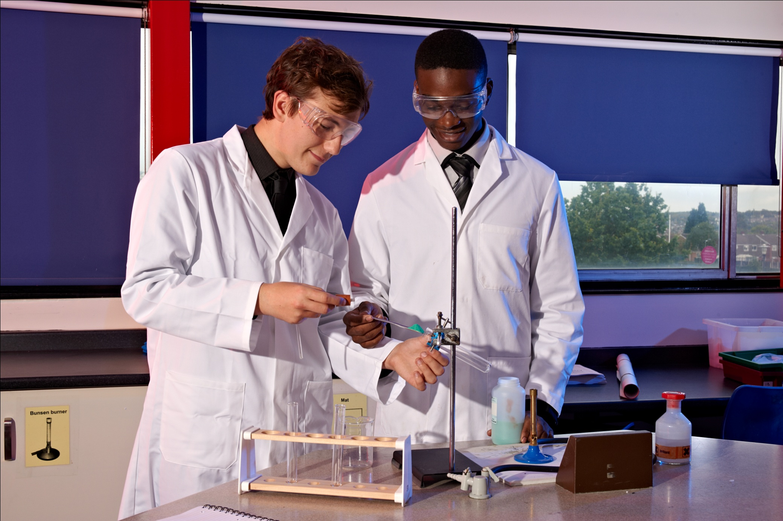
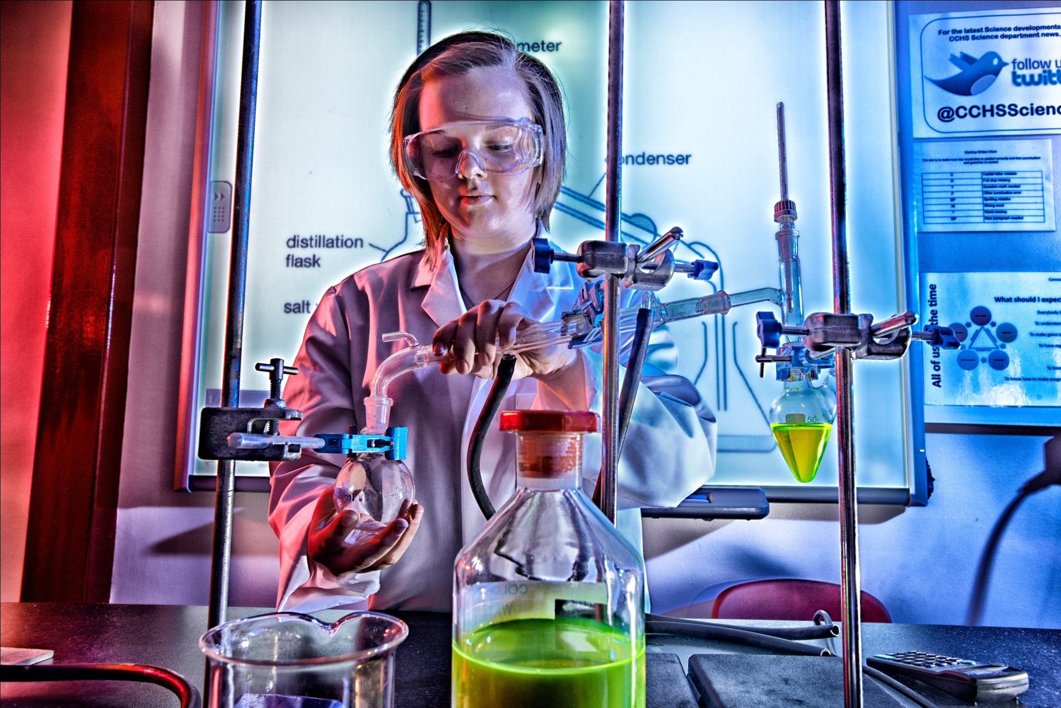
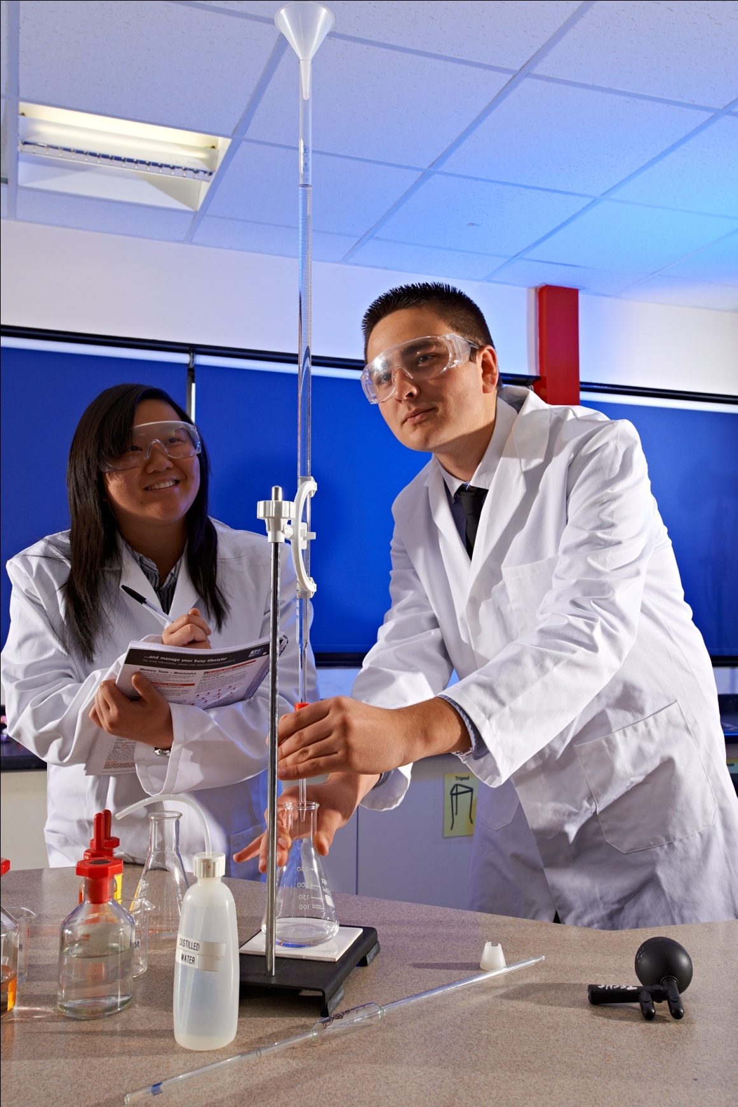
GCE: Chemistry
AQA

Slide 2
A-level Chemistry attempts to answer
the big question ‘what is the world
made of’ and it’s the search for
this answer that makes this subject
so fascinating. From investigating
how one substance can be changed
drastically into another, to researching
a new wonder drug to save millions
of lives, the opportunities that
chemistry provides are endless.

Slide 3
Course Content
Formulae, equations and amounts of substance
Atomic structure
Bonding and structure
Energetics and kinetics
Equilibria
Redox
Inorganic chemistry and the periodic table
Organic chemistry
Modern analytical techniques

Slide 4
Course Content

Slide 6
Practical endorsement
Minimum of 12 practical's
Need to keep separate practical record
Students that achieve will receive a PASS grade
Not needed for the AS qualification BUT will be assessed in the AS exams

Slide 7
AS stand alone qualification- 1 year of study

Slide 8
A Level- 2 years of study- replaces AS + A2

Slide 9
Why do Chemistry?
Universities think very highly of Chemistry students, they have to be the best of the best!
Develops transferrable thinking and application skills
Great Chemistry students exhibit excellent teamwork, networking, research and analytical skills and have a high sense of self motivation and self esteem!

Slide 10
Possible degree options
According to bestcourse4me.com, the top five degree courses taken by students who have an A-level in Chemistry are:
• Chemistry
• Biology
• Pre-clinical medicine
• Mathematics
• Pharmacology.
https://university.which.co.uk/advice/a-level-choices/what-a-levels-do-you-need-for-the-degree-you-want-to-study
Possible career options
Studying an A-level Chemistry related degree at
university gives you all sorts of exciting career
options, including:
• Analytical chemist
• Chemical engineer
• Clinical biochemist
• Pharmacologist
• Doctor
• Research scientist (physical sciences)
• Toxicologist
• Chartered certified accountant
• Environmental consultant
• Higher education lecturer
• Patent attorney
• Science writer
• Secondary school teacher.

Slide 12
What skills do I need?
Commitment to hard work
Enthusiasm, passion and skills in science (minimum of 2 6’s at combined/ 6 in triple science chemistry and a 6 in Maths) with the desire to develop a greater understanding of new concepts and principles
Willingness to develop a high level of experimental skills and safe working practice
Excellent mathematical skills (minimum grade 6 at GCSE) to use and manipulate numbers and formulae

Slide 13
What is expected of a level Chemists
5 hours of private study each week – minimum
Reading around the subject – magazines, books etc
To get to grips with the maths (it is tricky!)
To revise as you go along
To learn key words – word for word

Slide 15
Previous Chemistry students have gone on to great things!!!!
Courses our students have studied
Medicine
Pharmacology
Chemistry
Dentistry
Chemical engineering
Biomedical Science
Maths
Physics
Astrophysics

