Slide 1
Level 3 Extended Certificate in Children’s
Play, Learning and Development
BTEC Nationals 2016 NQF

Slide 2
General Information
Four Units
Two Year course
Work experience – 50 hours is compulsory
Work within any age groups 1- 7years 11 months
Must be in a setting that has OFSTED Good or Outstanding
Can do more work experience if you want!
Controlled assessment, opportunity to re-draft, improve and work towards higher grade

Slide 3
Unit 1 External Assessment
You will learn about the ways in which children grow and develop and the ways that the areas of development are interlinked.
You will look at theories relating to development and factors that influence children’s development.
The exam is for 1 hour 45 minutes and is out of 90 marks.
The exam windows are January and May/June

Slide 4
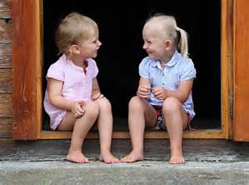
Unit 2 Controlled Assessment
Development of Children’s Communication, Literacy and Numeracy Skills

Slide 5
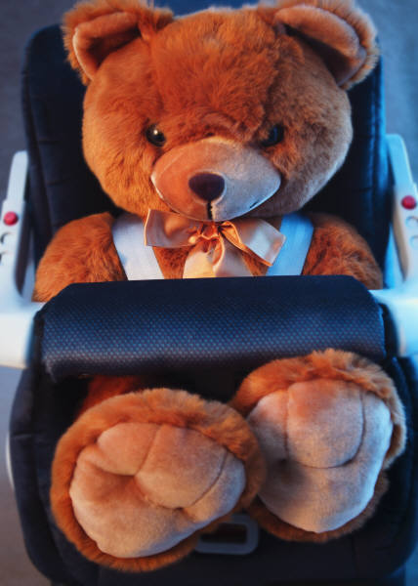
Unit 3 Internally Assessed Coursework
Unit 3 Play and Learning

Slide 6
Optional Units of Study
Unit 5: Keeping Children Safe
Unit 6: Children’s Physical Needs
Unit 8: Working with Parents and Others in Early Years
Unit 11: The EYFS.

Slide 7
How are these skills demonstrated?
Written work
Role Plays
Presentations
Arranging own work placement!
Attending placement and reflecting on own performance
Witness Statements
Teacher observing you in placement

Slide 8
What skills will you acquire?
Organisational Skills
Planning
Communication
Initiative
Professional conduct
Working in a child care setting – versatile
“People” skills
Care values

Slide 9
Am I suitable for this course?
What qualities do you need to have?
1. Do you LIKE children?
2. Willing to adapt to the needs of a childcare setting?
3. Enthusiastic?
4. Personable?
5. Mature and sensible?
6. Willing to develop your communication skills?

Slide 10
Where can this course lead me?
Further courses/ areas of study/ careers:
- Child Care – nursery/nanny/crèche/holiday company
- Children’s Nurse
- Teaching Assistant
- Teacher
- Social Worker
- Play Therapist
And many more

Slide 11
Where can I get more information?
Edexcel website:
BTEC Level 3 National Extended
Certificate in Children’s Play, Learning and
Development
For any further information please contact:
E. Hale e.hale@cannockchase-high.staffs.sch.uk
K. Ward k.ward@cannockchase-high.staffs.sch.uk

