Slide 1
AQA Biology
A level
Two year course

Slide 2
WHY STUDY BIOLOGY?
Develop skills such as logic, analysis, interpretation of data, Maths and research.
Directly relevant for a range of careers.
A living subject with a dramatic pace of change; links to ethical and moral issues.
Develop practical skills and independent learning styles.
It is known as ‘a facilitating subject’. Which? University says the phrase describes “a handful of A level subjects commonly asked for in universities’ entry requirements, regardless of the course you are applying to”

Slide 3
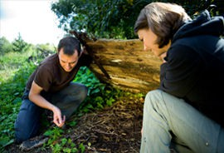
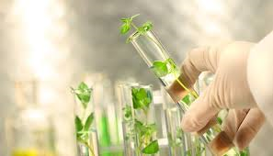
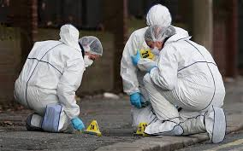
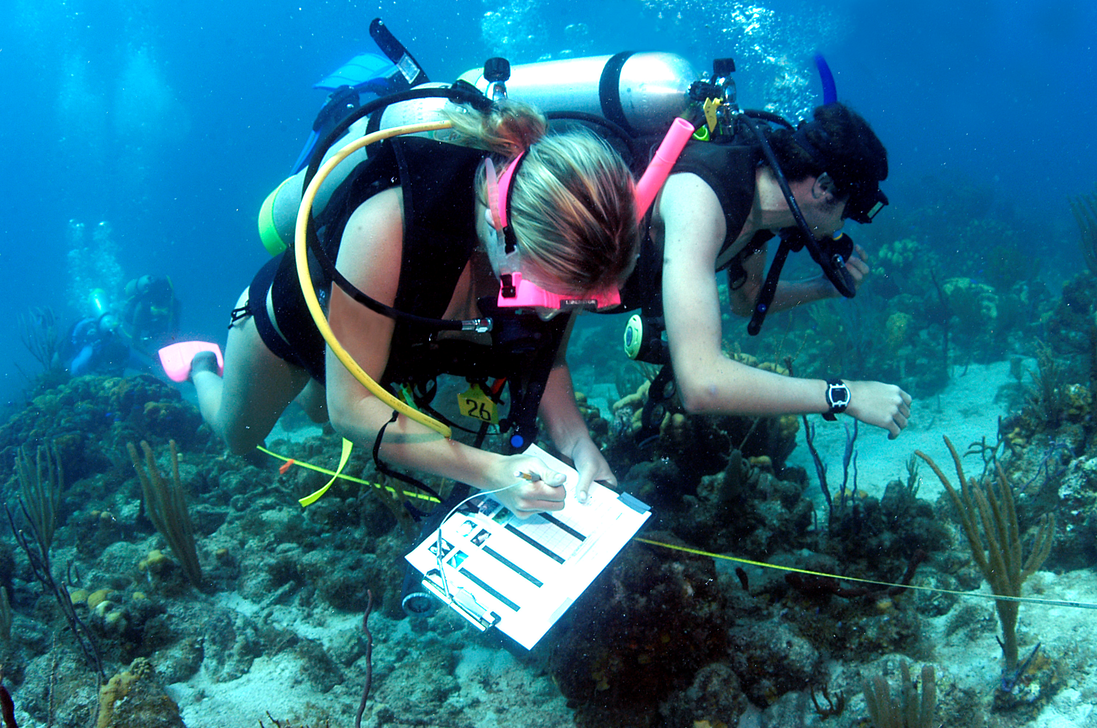
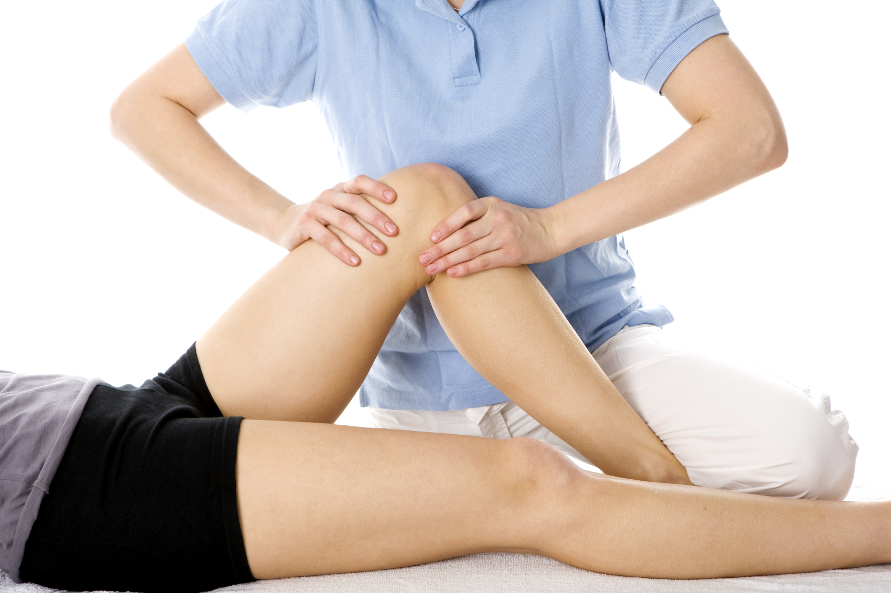
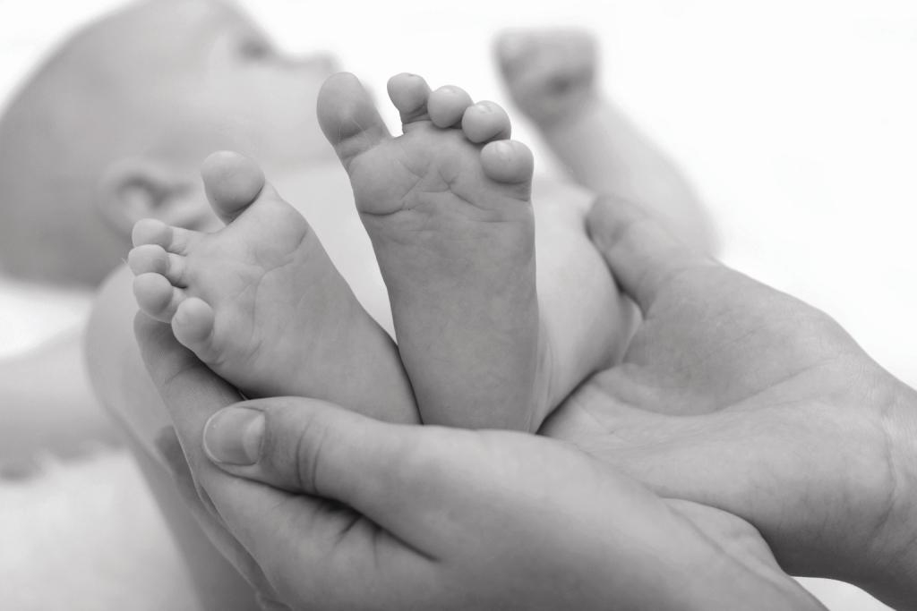
Range of Careers
Physiotherapy
Medicine
Nursing
Veterinary Science
Midwifery
Research –academic/ industrial
Ecological
Marine
Pharmaceutical
Molecular Genetics
Clinical Trials
Pharmaceutical Sales
Pathology
Embryology
Forensic Scientist
Animal related jobs
Biomedical Science

Slide 4
Year 12 4 Units
Teacher 1 | Teacher 2
2 -Cells | 1 -Biological Molecules
3 – Organisms exchange substances with their environment | 4 – Genetic information, variation and relationships between organisms

Slide 5
Assessments for year 12 (Internal Examination)
Paper 1
Any content from unit 1-4 +practical skills
1hr 30mins
75 marks
65 marks short answer
10 marks comprehension question
Paper 2
The same but extended response questions instead of comprehension

Slide 6
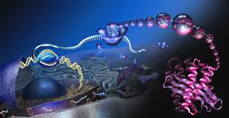
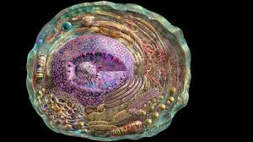
Cells
Cell structure
Eukaryotic and prokaryotic
Microscopes
Mitosis and Cancer
Transport across membranes
Cells and the immune system

Slide 7
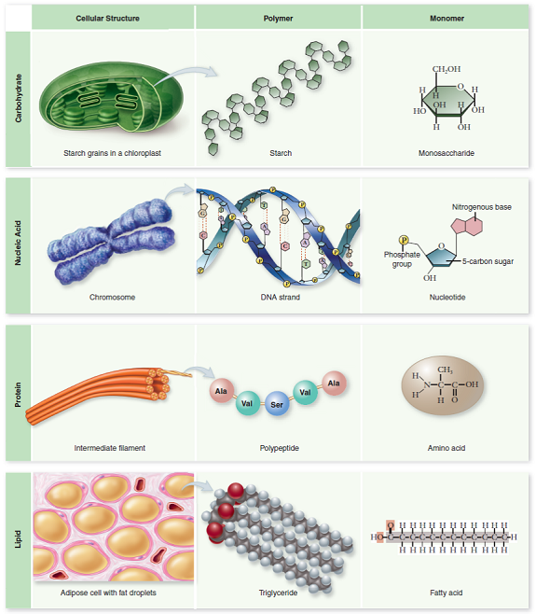
Biological Molecules
Carbohydrates
Lipids
Proteins
Enzymes
Nucleic acids
DNA replication
ATP
Water
Inorganic ions

Slide 8
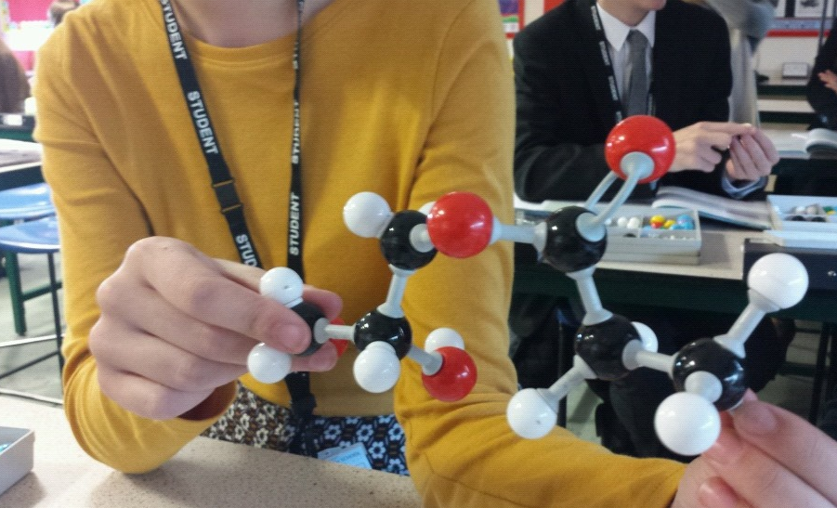

Slide 9
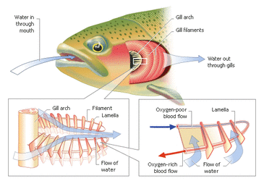
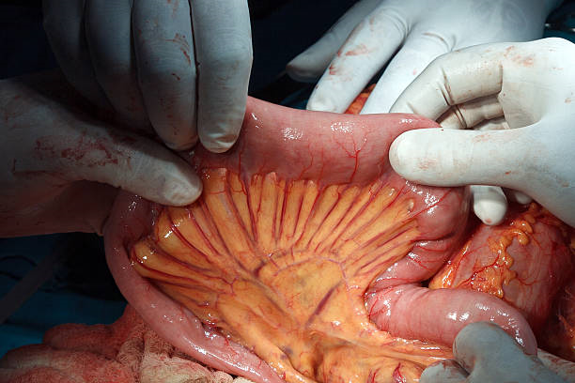
Organisms exchange substances with their environment
Gas exchange – lungs, gills plants
Digestion and absorption
Mass transport – Cardiovascular system
Mass transport in plants

Slide 10
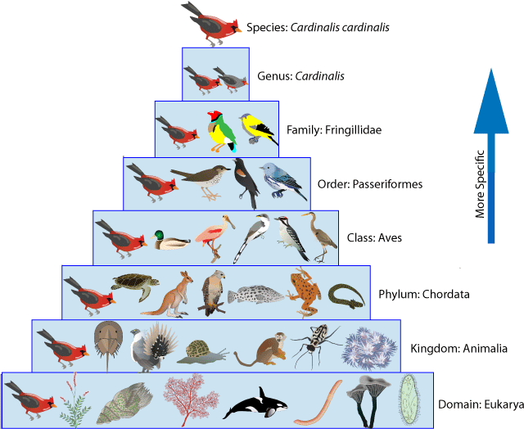
Genetic information, variation and relationships between organisms
DNA, genes and chromosomes
DNA and protein synthesis
Genetic diversity – Meiosis
Genetic diversity and adaptation
Species and taxonomy
Biodiversity within a community
Investigating diversity

Slide 11
Assessment for A2/Year 13 (External exam)
Paper 1 | Paper 2 | Paper 3
Any content from units 1-4 | Any content from units 5-8 | Any content from units 1-8
2 hours | 2 hours | 2 hours
91 marks | 91 marks | 78 marks
35% of A level | 35% of A level | 30% of A level
76 marks : long and short answer questions | 76 marks : long and short answer questions | 38 marks: structured questions including practical techniques
15 marks : extended response questions | 15 marks : comprehension question | 15 marks: critical analysis of given experimental data
 |  | 25 marks , one essay from two choices of title

Slide 12
A2 Content
Teacher 1 | Teacher 2
Energy transfers in and between organisms | Organisms responding to changes in their internal and external environment
Genetics, populations, evolution and ecosystems | The control of gene expression

Slide 13
Maths
10% of A level is maths
Converting units
Standard form
Calculating ratios and percentages
Estimating results
Interpreting and analysing data
Understanding probability
Select and use statistical tests
Understand measures of dispersion e.g. standard deviation
Understand and solve algebraic equations
Using logarithms
Plot and calculate data from graphs

Slide 14
Practical assessments assessed in written papers
In order to be able to answer these questions, students need to have been taught, and to have acquired competence in, the appropriate areas of practical skills
A level has a separate practical endorsement of skills

Slide 15
Practical endorsement
Minimum of 12 practical assignments
6 in year 12
6 in year 13
Need to keep a separate practical record
Students that achieve will receive a PASS grade

Slide 16
What we expect!
5 hours of private study each week – minimum
Reading around the subject – magazines, books etc.
To get to grips with the maths (it is tricky!)
To revise as you go along
To learn key words – word for word

Slide 17
