Slide 1
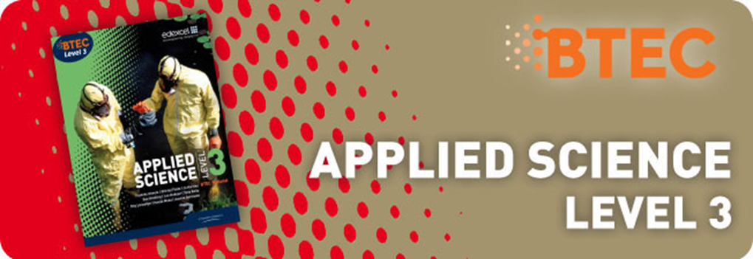

Slide 2
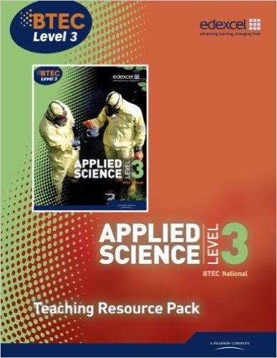
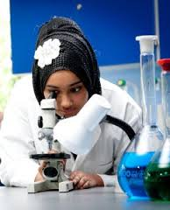
Introduction
This vocational qualifications is aimed at post-16 learners looking for a practical introduction to science. They're suitable for studying alongside academic science qualifications, such as A-levels or other Level 3 vocational qualifications.
Designed to cover engaging areas of study including Applied experimental techniques and Science in the modern world.
There’s an opportunity to undertake a scientific investigation, and optional units in Biology, Chemistry and Physics. Through a combination of internally marked and externally assessed units, these qualifications will provide learners with the opportunity to apply their knowledge in a practical and relevant way.

Slide 3
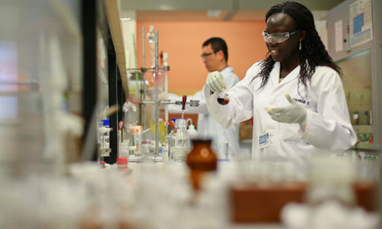
Aims of the Course:
The Edexcel BTEC qualifications in this specification are a suite of qualifications that reflect aspects of
employment within science organisations or organisations that use science and enable learners to develop practical scientific skills. These qualifications will appeal to learners who prefer portfolio-based assessment covering a variety of scientific investigations.
Units within the qualification cover areas of laboratory science, forensic science, medical science,
environmental science and biological, chemical and physical science to provide a route to employment in the science industry or within organisations that use science.

Slide 4
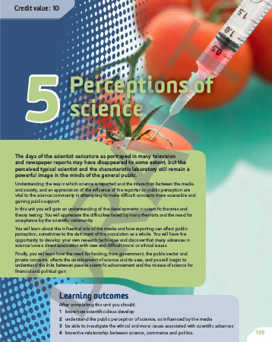
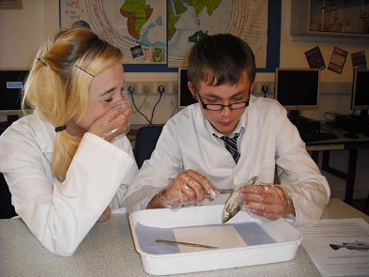
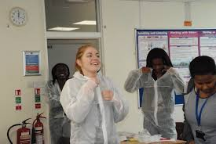
Course Requirements
To be considered for the course pupils are required to obtain a minimum:
. A minimum of grade 5 in GCSE Combined science or at least grade 5 in each of the separate GCSE sciences Biology, Chemistry and Physics. Also a minimum of grade 5 in GCSE English and Maths is required

Slide 5
Applied Science Level 3 BTEC
Courses Available:
Edexcel BTEC Level 3 Certificate in Applied Science
Edexcel BTEC Level 3 Extended Certificate in Applied Science

Slide 6
Why do Btec Applied Science?
Universities think highly of Btec Applied Science students, their ability to work practically and apply skills to vocational courses like Forensic Science, Sport Scientist, Analytical chemists etc.
Develops transferrable thinking and application skills.
Great Science students exhibit excellent practical skills, teamwork, networking, research and analytical skills and have a high sense of self motivation and self esteem with a great work ethic!

Slide 7
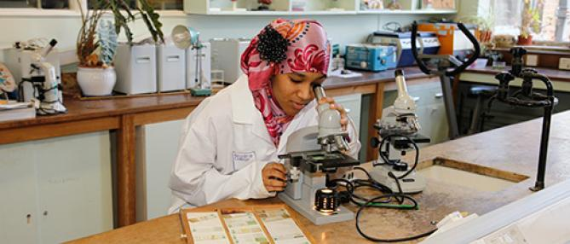
Certificate 180 GLH
UNITS 2 MANDATORY UNITS
1. Principles and Applications of Science I (90 GLH)
2. Practical Scientific Procedures and Techniques (90 GLH)
0 OPTIONAL UNITS

Slide 8
Course Content:
There are 2 units in the Edexcel BTEC Level 3 Certificate in Applied Science. These are Mandatory units and together form a course which is broadly equivalent to 1 AS.
Unit 1 Principles and Applications of Science
Unit 2 Practical Scientific Procedures and Techniques
The Edexcel BTEC Level 3 Extended Certificate in Applied Science is a 360 guided learning hour (GLH) qualification that consists of three mandatory units (two of which, Units 1 and 2, are covered in the Certificate course) plus an optional unit. These optional units will vary from year to year depending on staff specialisms but will aim to offer a broad range of Science. The three mandatory and one optional unit together form a course which is broadly equivalent to 1 full A level.

Slide 9
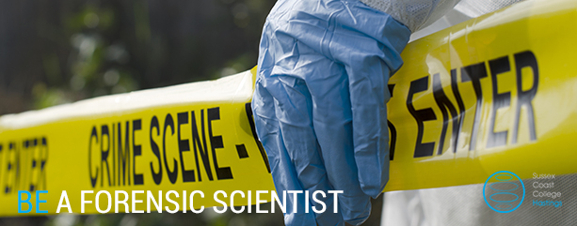
Extended Certificate 360 GLH
TOTAL: 4 UNITS
3 MANDATORY UNITS
1. Principles and Applications of Science I (90 GLH)
2. Practical Scientific Procedures and Techniques (90 GLH)
3. Science Investigation Skills
(120 GLH)
1 OPTIONAL UNIT – Unit 8 Physiology of Human Body Systems

Slide 10
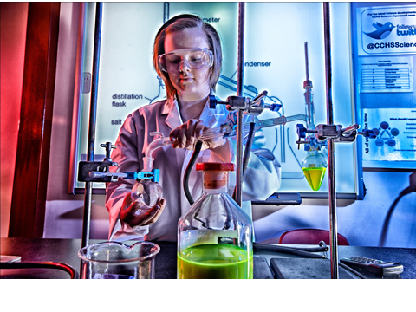
Assessment:
All assessment is carried out through a combination of internally set assignments; Exam Board set tasks and Written Exams as follows:
Certificate:
Unit 1 Principles and Applications of Science - Written External Examination
Unit 2 Practical Scientific Procedures and Techniques - Internal Assessed Assignments
Extended Certificate:
Unit 3 Science Investigation Skills - Externally set task
Optional Unit – Internally Assessed Assignments

Slide 14
What does Applied Science Btec actually look like?
Pupils undertake a series of project based assignments, extended practical investigations that are set within a vocational context.
The exam is worth at least 30% and the course is designed for pupils who do better in a vocational context.

Slide 15
Place that good qualifications in Btec could take You !!!!
Nursing
Pharmacology
Environmental Science
Dentistry
Chemical engineering
Biomedical Science
Forensic Science
Sports Science

Slide 16
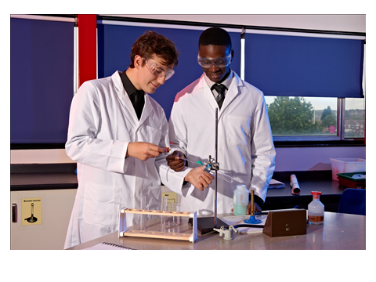
The BTEC course prepares for real jobs in the Science industry.
These can include roles such as:
working as a quality control technician/analyst, ICT and data interpretation, working in a hospital as a medical physics technician supporting the use of X-ray and other imaging/ scanning equipment, working in a research laboratory in the development of new drugs. Managing projects that include setting up apparatus, measuring and handling chemical substances, working in the chemical industry, involved with testing materials , working with the forensic science service or using their analytical skills in the chemistry industry.

