Slide 1
Information Technology
Level 3 BTEC Nationals Extended Certificate
Open Evening 2020

Slide 2
Course Title
Pearson BTEC Level 3 National Extended Certificate in Information Technology
360 GLH
QAN code: 601/7575/8
Full details of the course can be found:
http://qualifications.pearson.com/en/qualifications/btec-nationals/information-technology-2016.html#tab-2

Slide 3
If you are interested in IT and Computing careers but not sure where this will lead then click on this link to find out more
https://btecworks.com/teacher/courses/pwbwhv

Slide 4
What will I have to do?
360 Guided Learning Hours (GLH)
4 units – 3 Mandatory, 2 External Assessments
83% Mandatory
58% External

Slide 5
Course Outline
Mandatory Units
Unit 1 IT Systems (120 GLH)
External assessment
Unit 2: Creating Systems to Manage Information (90 GLH)
External assessment
Unit 3: Using Social Media (90 GLH)
Optional Units – One of the following
Data Modelling (90 GLH)
Website Developing (90 GLH)

Slide 6
Course structure

Slide 7
Grading of Units
Units are assessed using a grading scale of Distinction, Merit, Pass and Unclassified though the qualification allows for a Distinction* overall
All mandatory and optional units contribute proportionately to the overall qualification grade
For example a unit of 120 GLH will contribute double that of a 60 GLH unit

Slide 8
Why choose BTEC Information Technology?
Established and successful qualification
Work related – designed to accommodate learners as well as the needs of employers
Each unit is assessed through the completion of assignments designed around a range of evidence types

Slide 9
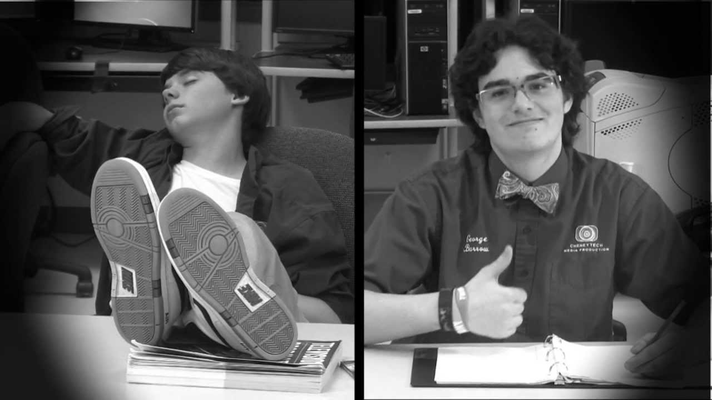
Who is best suited for this course?
This qualification is designed for learners who are interested in an introduction to the study of creating IT systems to manage and share information alongside other fields of study
The qualification allows you to progress to a wide range of higher education courses, not just in IT

Slide 10
Is there a learner entry requirement?
We expect learners to have qualifications at or equivalent to Level 2
Learners are most likely to succeed if they have:
GCSE Computer Science grade 5 or above
Creative iMedia at a level 2 Merit or above
Five GCSEs at good grades – grade 5 or above
Achievement in English and Mathematics through GCSE

Slide 11
University Recognition
Kingston University
Southampton Solent University
University of Chichester
University of East Anglia
University of Exeter
University of Sheffield
University of West of England
University of Huddersfield

