Slide 1
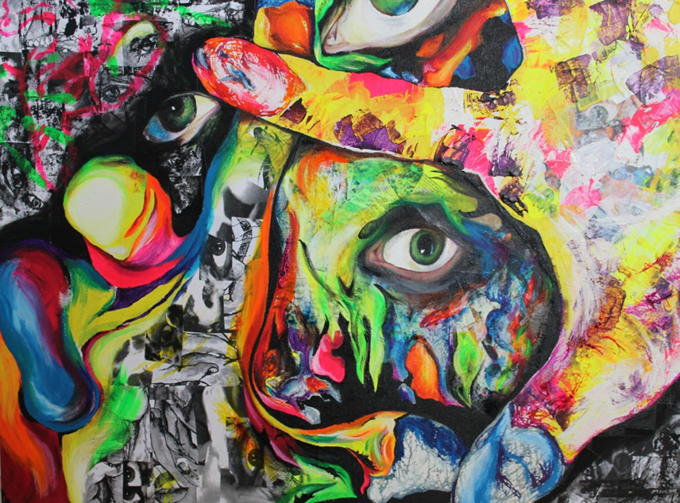
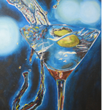
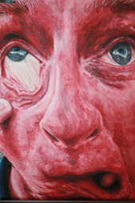
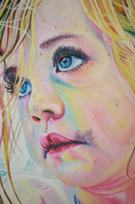
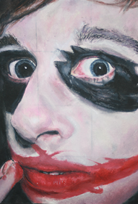
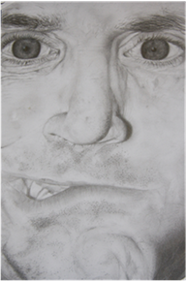

Slide 2
A Level
Changes – We are currently working with a two year A Level course, unlike previous years when students completed AS Level then A Level in year 13.
Make the right decision – Students should have already completed a GCSE in art and be able to demonstrate a good level of artistic, literacy and analytical skills. All students are expected to complete practical work over the summer in preparation for September.

Slide 3
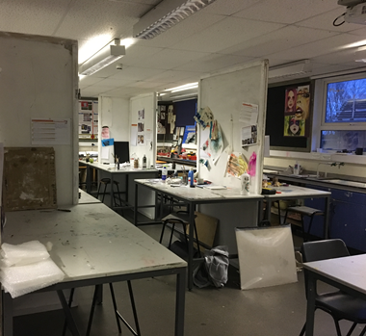
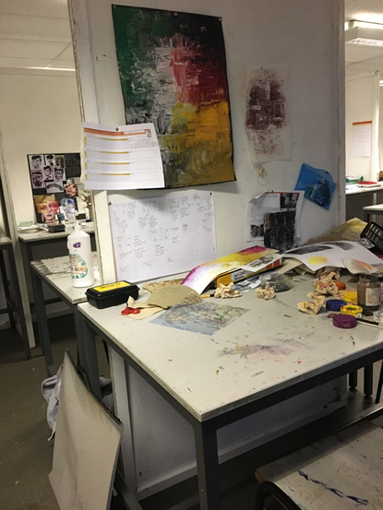
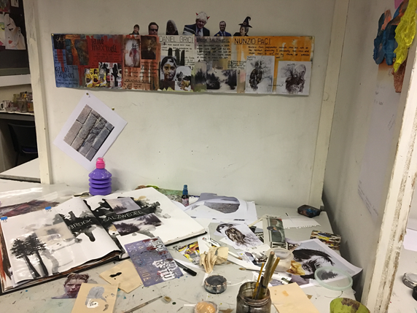
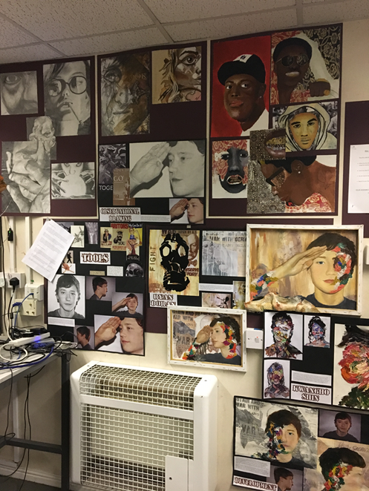
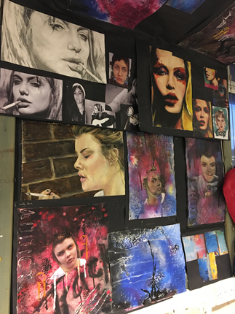
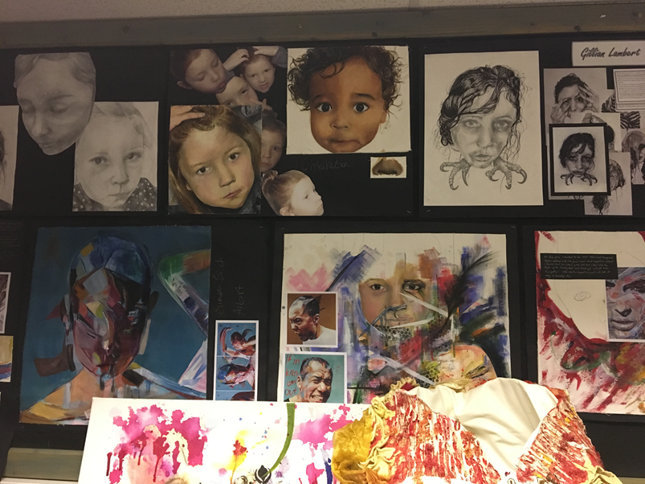

Slide 4
A Level
Unit 1 (60% of A Level grade): A personal investigation based on an idea, issue or concept of your choice, supported by 1000-3000 word written investigation. Students select their own starting point for the Personal Investigation. Students can develop their own personal preferences, leading to more independent thinking and development of work.
Unit 2 (40% of A level grade): Externally set assignment. Examination papers are released to students during the first school week in February.

Slide 5
How is the course structured?
Component 1 : Personal Investigation
Incorporates 3 major elements – supporting studies, practical work and a researched, written study (min 1000 words).
Unit assessment – for all components the work must cover all four assessment objectives (Aos) Develop, Explore, Record and Present.
60% of the total qualification.
Component 2 : Externally Set Assignment (ESA)
The ESA incorporates 2 major elements – Preparatory studies and 15 hours of sustained focus (exam).
40% of the total qualification.
All work will be internally assessed and externally moderated. The 15 hour sustained focus will be held over 3 consecutive sessions.

Slide 6
ASSESSMENT OBJECTIVES ARE MUCH THE SAME, BUT A DIFFERENT ORDER
DEVELOP – sustained & focused ideas informed by contextual/ artists sources
EXPERIMENT – with resources, materials, techniques by reviewing & modifying
RECORD – ideas & observations, reflect on work in progress
PRESENT – realise intentions through a personal & informed response
PRACTICAL COURSEWORK PROJECT
PRACTICAL EXAM
Useful links;
The student art guide
Pinterest
Creativejourneyuk.org

